Slide 1
Lecture 7: Model Selection and Regularization

Slide 2
ANNOUNCEMENTS
Study break next week (TBD):
Pizza and fun
Homework:
HW1 Grades will be released sometime today. Median = 4.8, STD= 0.60
HW3: 2 weeks and thus longer.
Read the submission instructions – please.
Use the pre-made groups

Slide 3

ANNOUNCEMENTS

Slide 4
ANNOUNCEMENTS
Projects:
Acquiring, organizing, and working with real data.
Collaborating with your peers.
Integrating statistics and machine learning methods.
Working with an open ended problems. Find optimizable second-best approach for problems that can NOT be solved.
Communicating your work to others.
Engage fully with the Data Science process—in all its non-linearity—in a real world project situation.

Slide 5
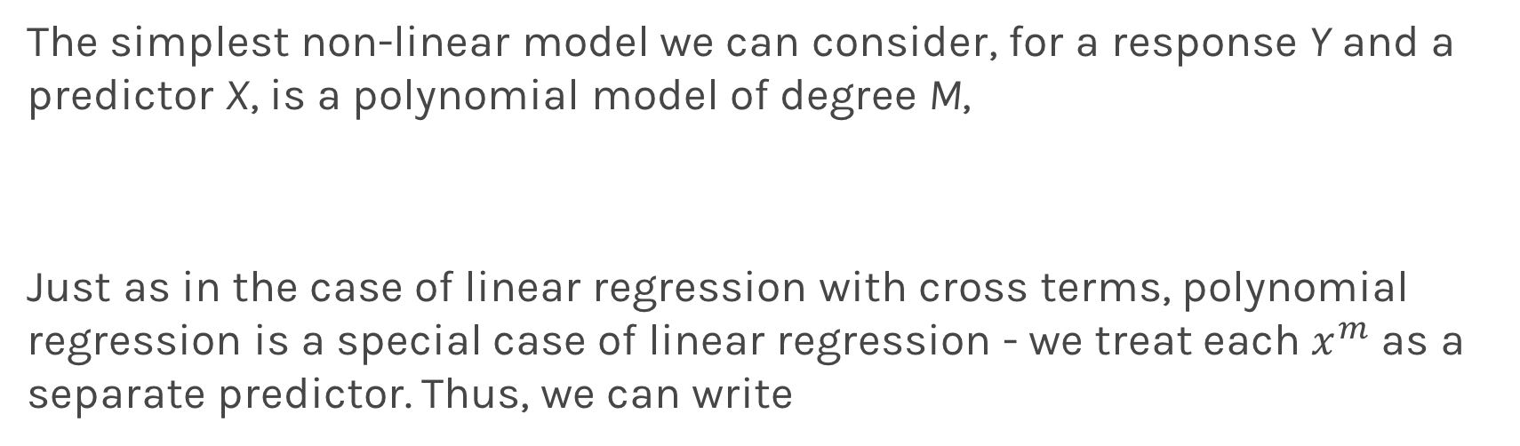
Polynomial Regression
The simplest non-linear model we can consider, for a response Y and a predictor X, is a polynomial model of degree M,
Just as in the case of linear regression with cross terms, polynomial regression is a special case of linear regression - we treat each $x^{m}$ as a separate predictor. Thus, we can write

Slide 6
Polynomial Regression
Multi-Regression
n
Poly-Regression

Slide 7
Lecture Outline
Overfitting
Model Selection
Cross Validation
Bias vs Variance
Regularization: LASSO and Ridge
Regularization Methods: A Comparison

Slide 8
Lecture Outline
Overfitting
Model Selection
Cross Validation
Bias vs Variance
Regularization: LASSO and Ridge
Regularization Methods: A Comparison

Slide 9
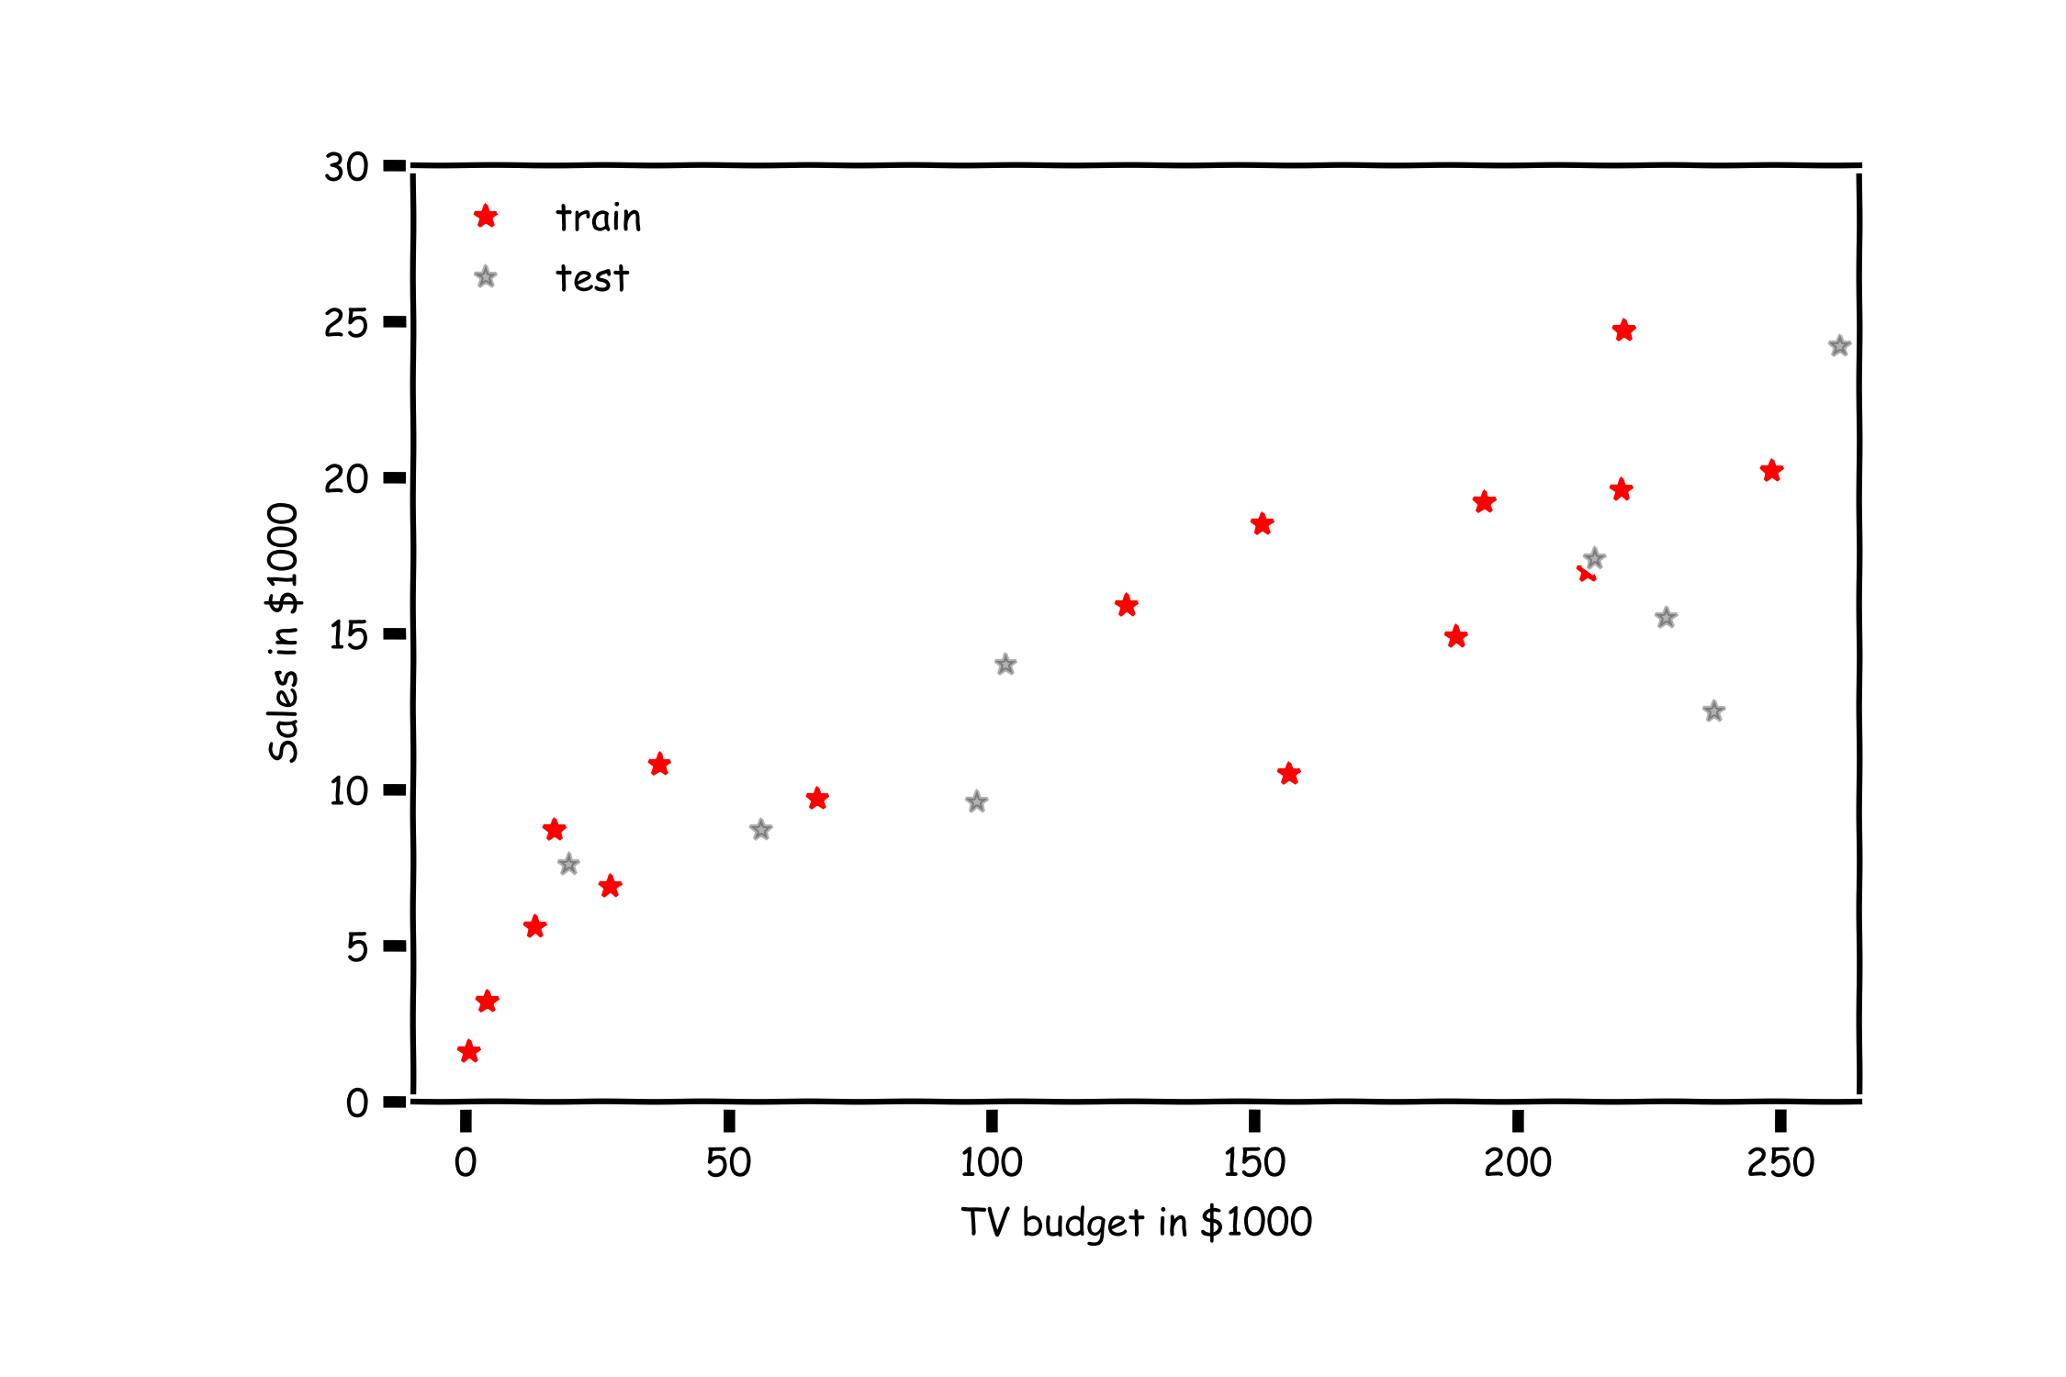
Overfitting

Slide 10
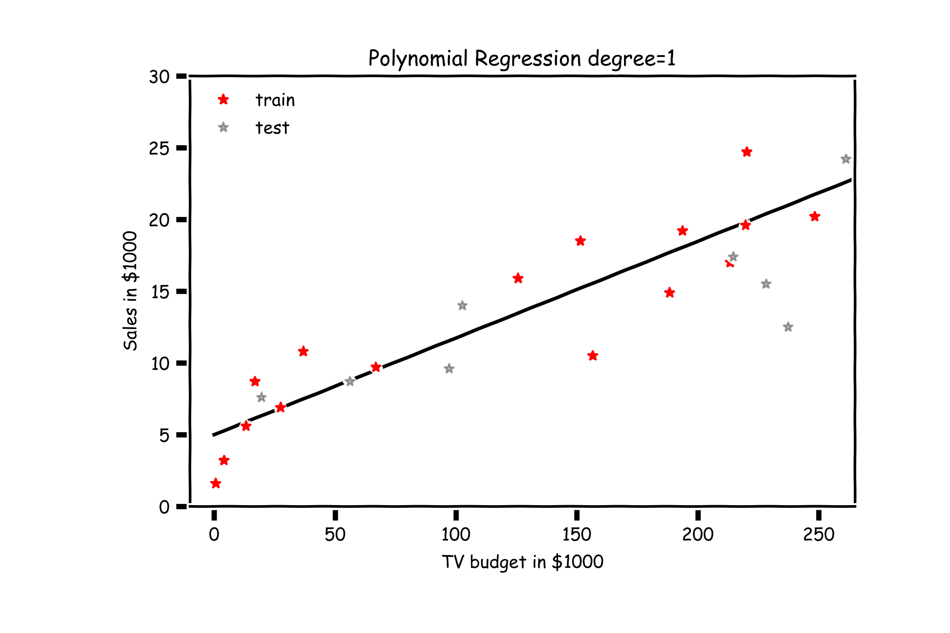
Overfitting

Slide 11
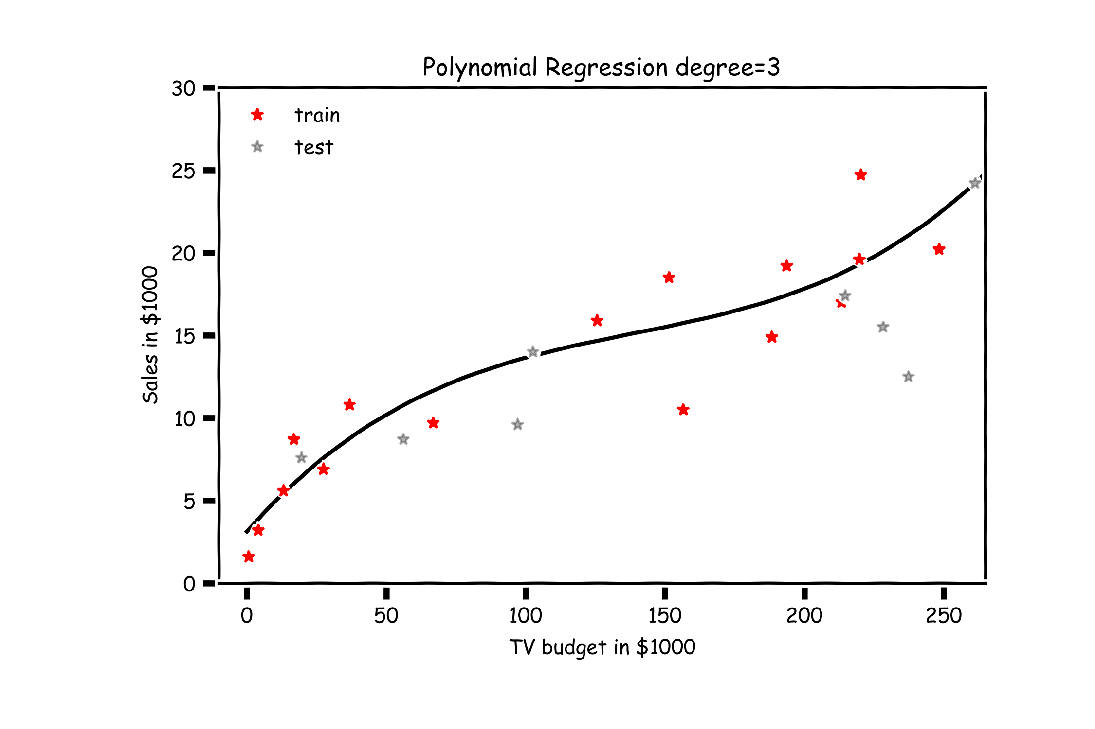
Overfitting

Slide 12
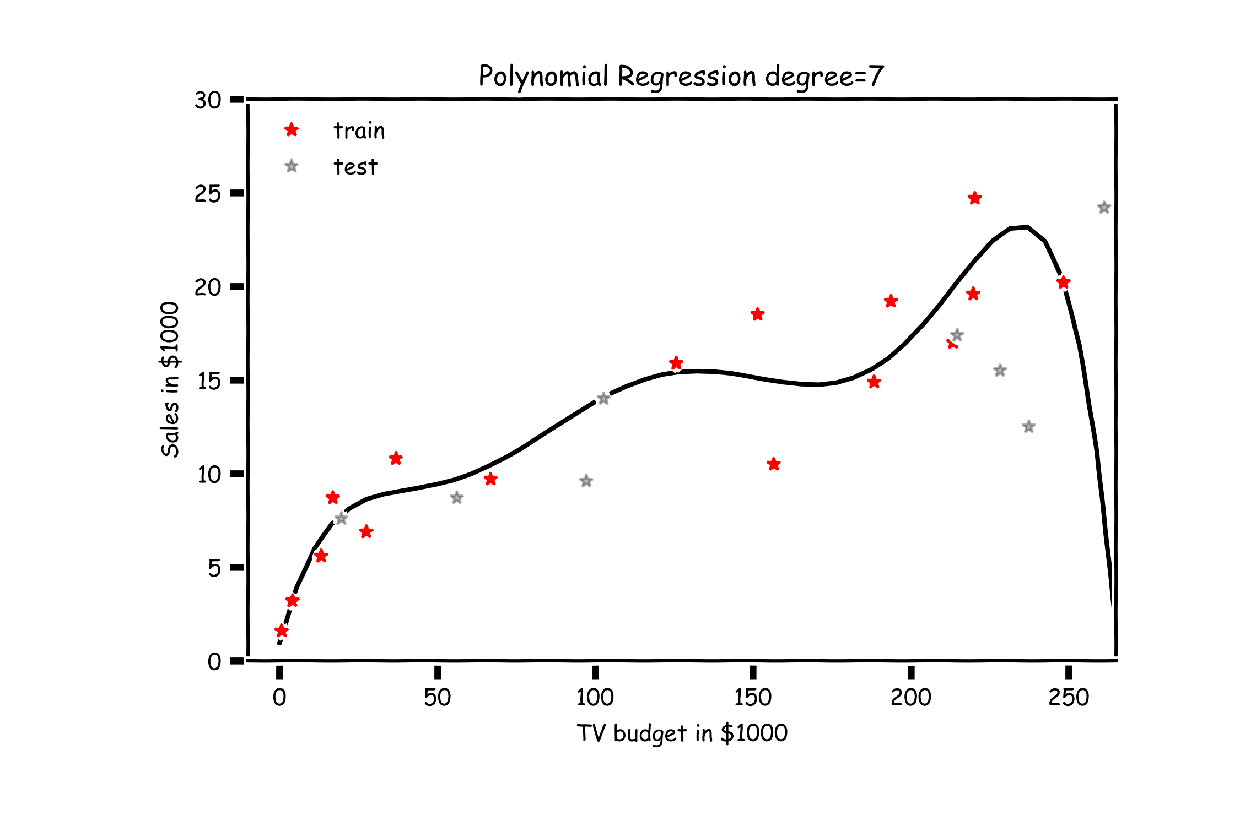
Overfitting

Slide 13
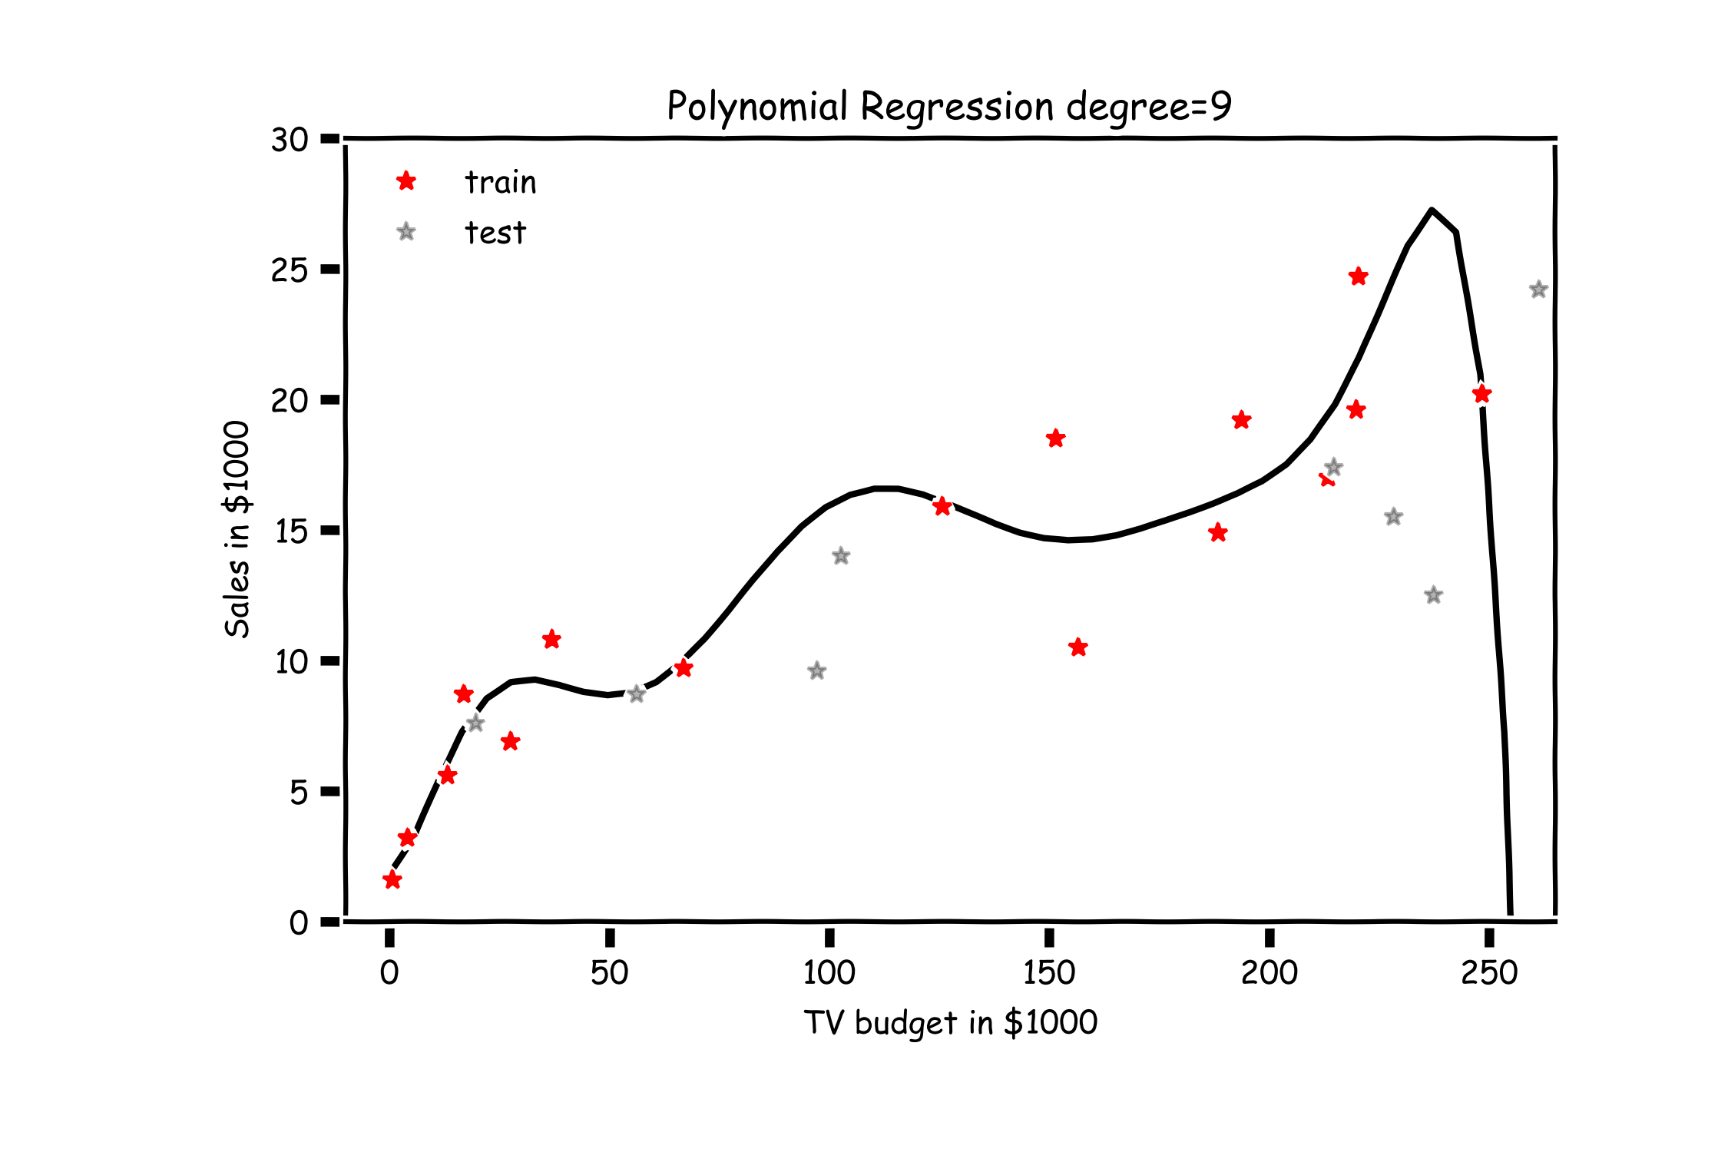
Overfitting

Slide 14
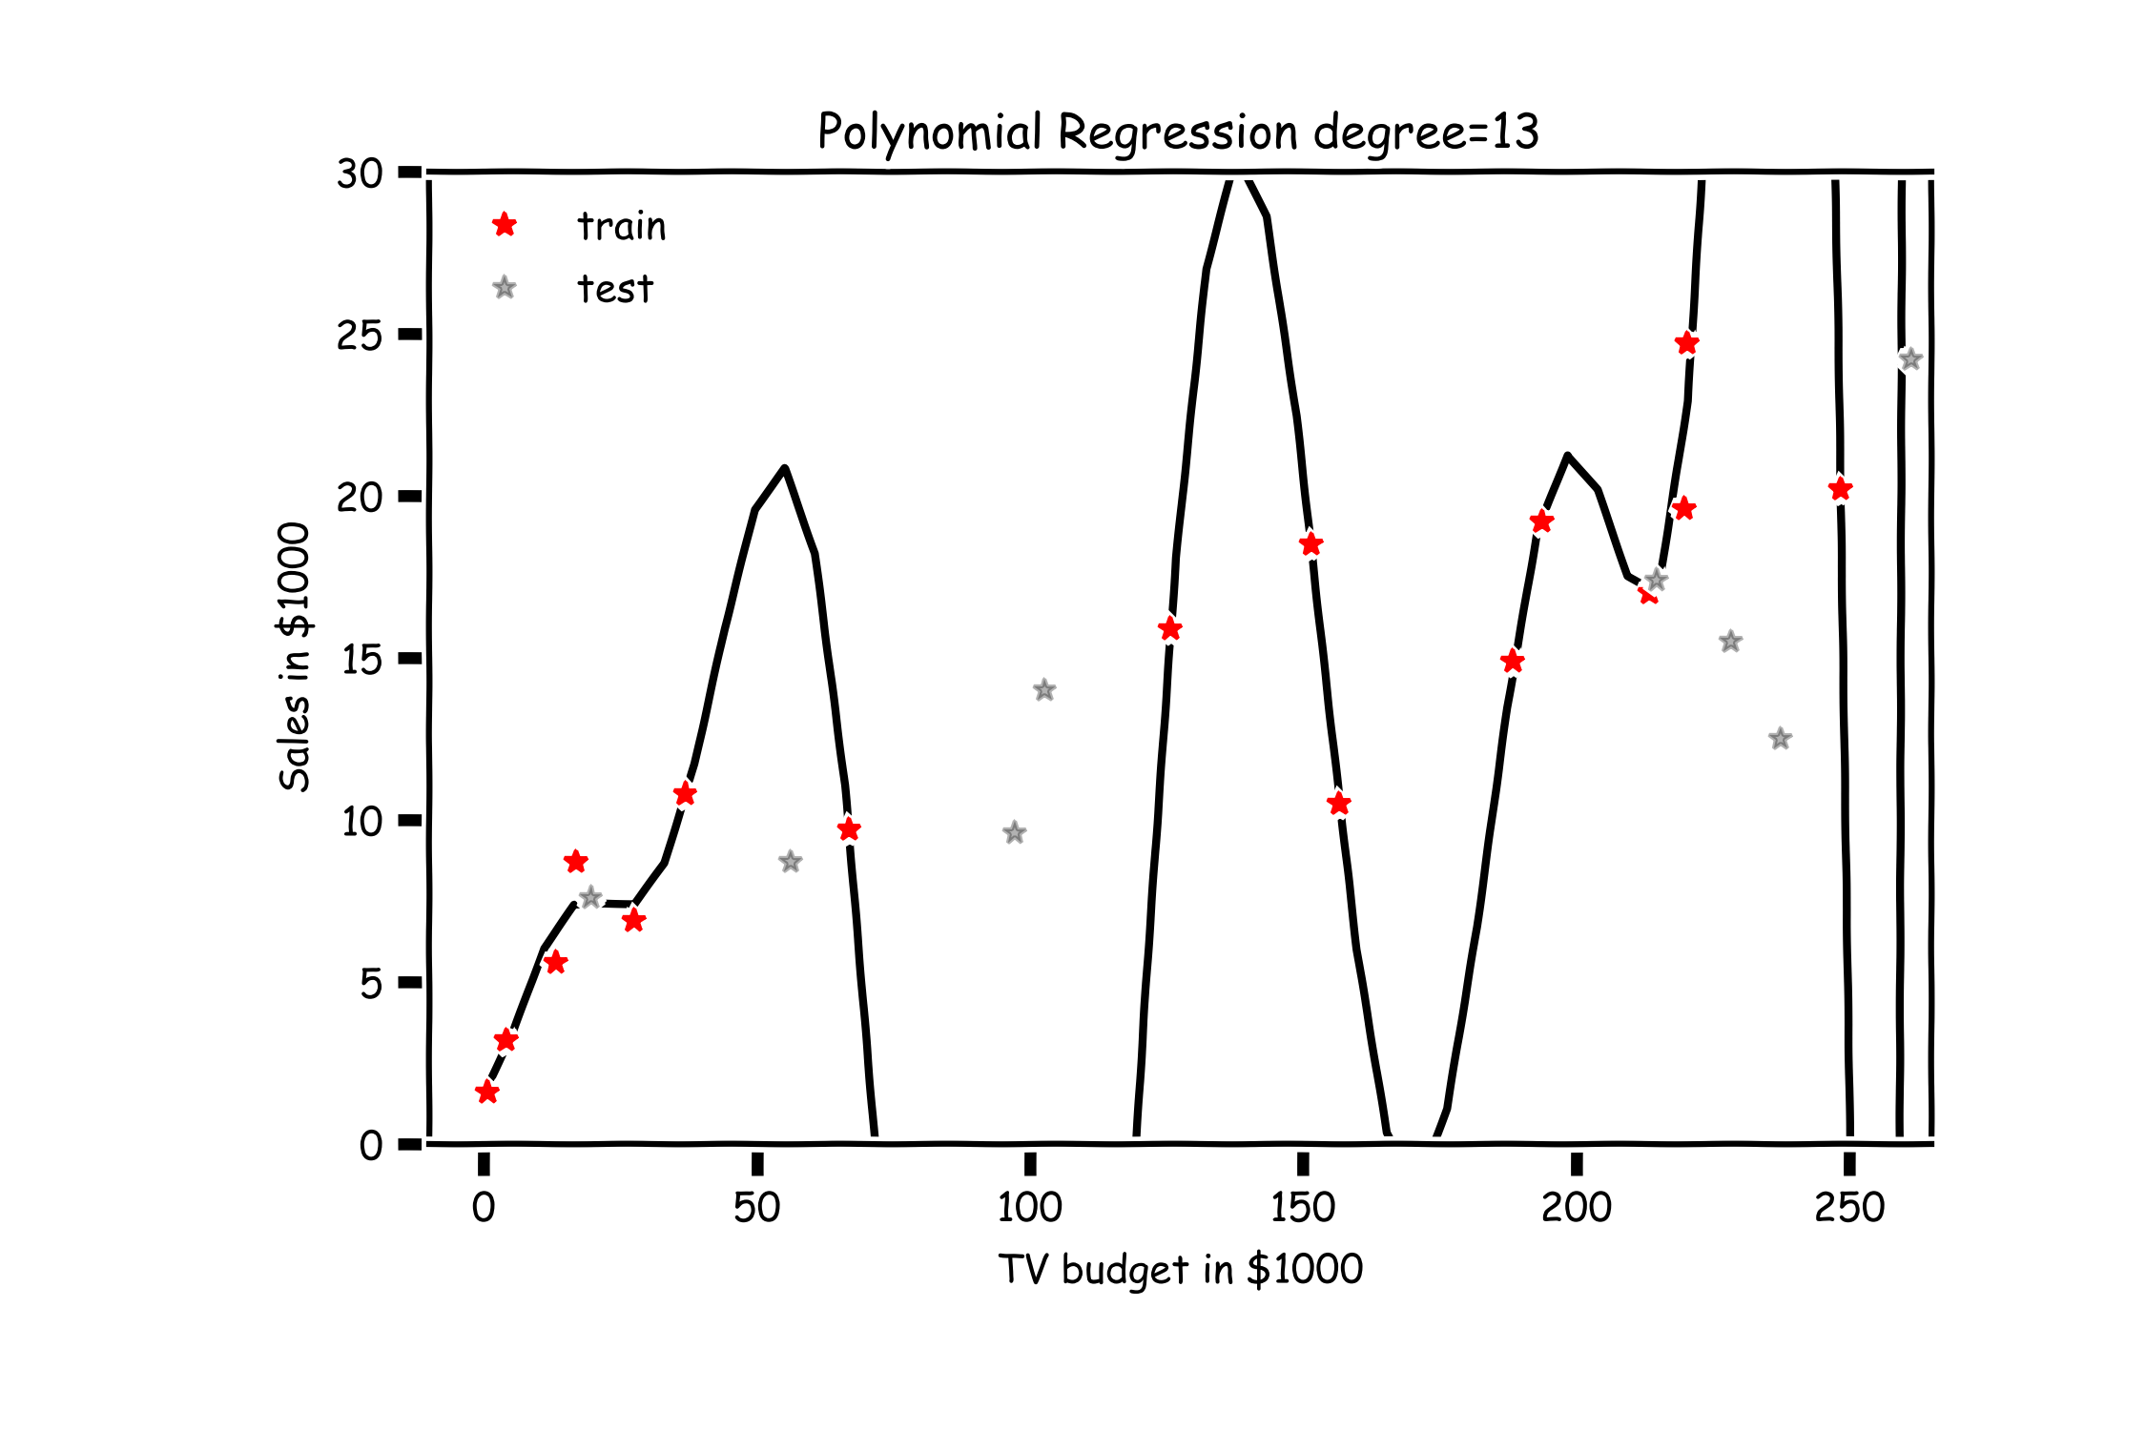
Overfitting

Slide 15
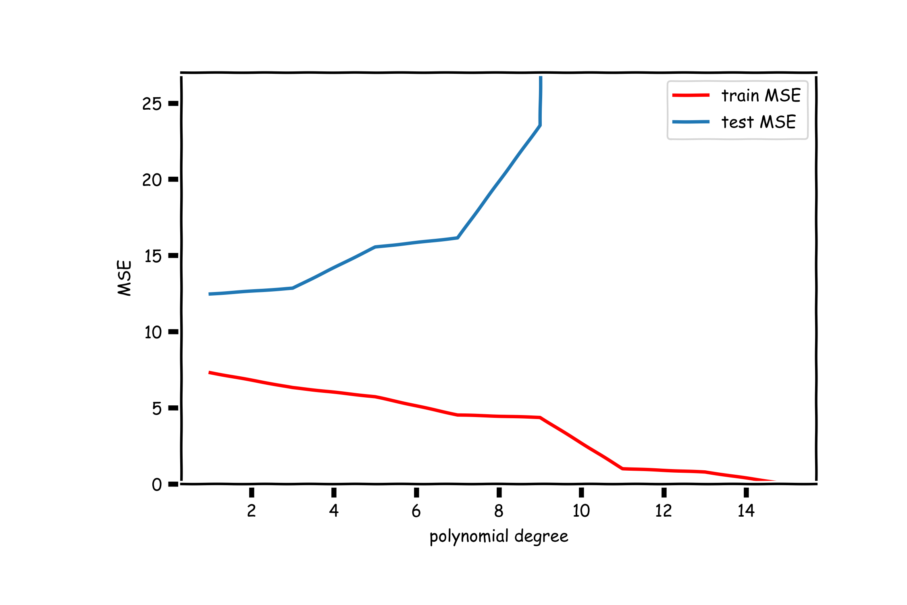
Validation

Slide 16
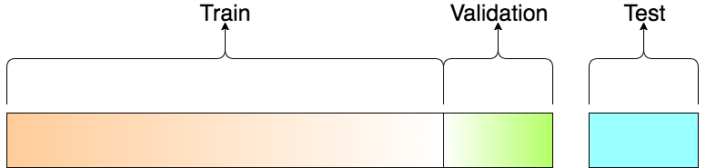
Train-Validation-Test
Question:
How would you report the performance of the model?
R2_test = 0.52
R2_train(degree=1) = 0.83

Slide 17
Lecture Outline
Overfitting
Model Selection
Cross Validation
Bias vs Variance
Regularization: LASSO and Ridge
Regularization Methods: A Comparison

Slide 18
Model Selection
Model selection is the application of a principled method to determine the complexity of the model, e.g. choosing a subset of predictors, choosing the degree of the polynomial model etc.
A strong motivation for performing model selection is to avoid overfitting, which we saw can happen when:
there are too many predictors:
the feature space has high dimensionality
the polynomial degree is too high
too many cross terms are considered
the coefficients values are too extreme (we have not seen this yet)

Slide 19
Model Selection
Question:
How many different models when considering J predictors?

Slide 20
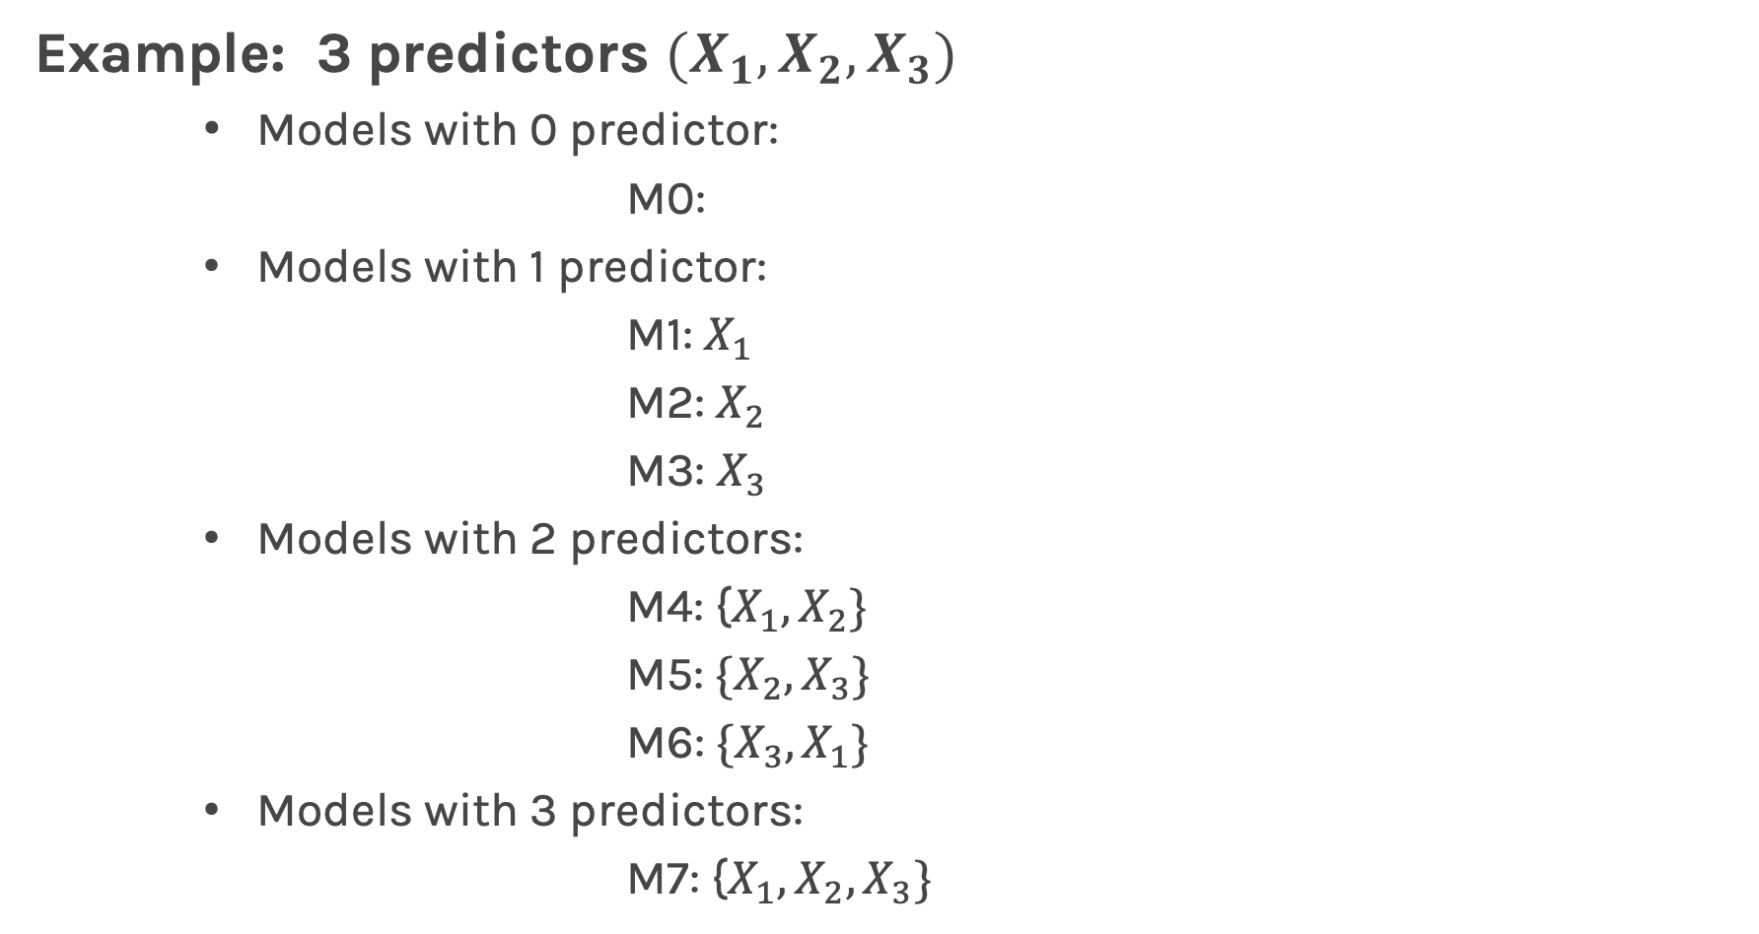

Model Selection
Example: 3 predictors $(X_{1},X_{2},X_{3})$
Models with 0 predictor:
M0:
Models with 1 predictor:
M1: $X_{1}$
M2: $X_{2}$
M3: $X_{3}$
Models with 2 predictors:
M4: {$X_{1},X_{2}\}$
M5: ${\{X}_{2},X_{3}\}$
M6: ${\{X}_{3},X_{1}\}$
Models with 3 predictors:
M7: {$X_{1},X_{2},X_{3}\}$
$$2^{J} Models$$

Slide 21
Stepwise Variable Selection and Cross Validation
Selecting optimal subsets of predictors (including choosing the degree of polynomial models) through:
stepwise variable selection - iteratively building an optimal subset of predictors by optimizing a fixed model evaluation metric each time,
validation - selecting an optimal model by evaluating each model on validation set.
We will also address the issue of discouraging extreme values in model parameters later.

Slide 22
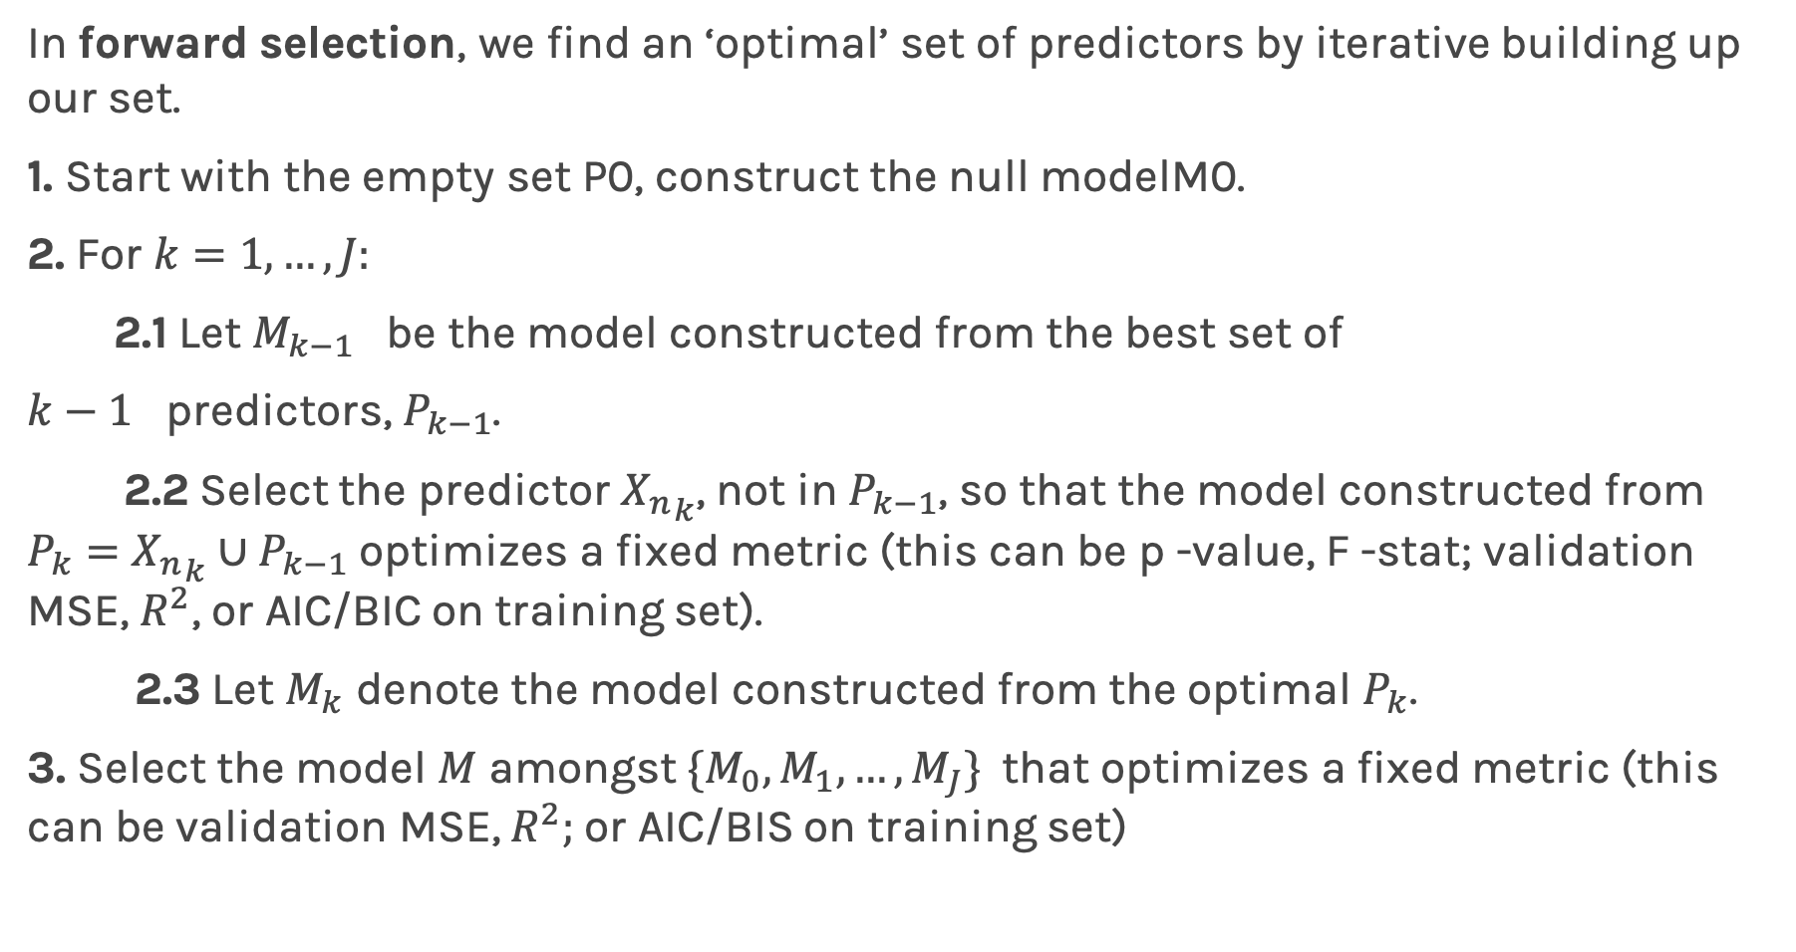
Stepwise Variable Selection: Forward method
In forward selection, we find an ‘optimal’ set of predictors by iterative building up our set.
1. Start with the empty set P0, construct the null modelM0.
2. For $k=1,…, J:$
2.1 Let $M_{k−1}$ be the model constructed from the best set of
$k−1$ predictors, $P_{k−1}$.
2.2 Select the predictor ${X_{n}}_{k}$, not in $P_{k−1}$, so that the model constructed from $P_{k}=$ ${X_{n}}_{k}∪P_{k−1}$ optimizes a fixed metric (this can be p -value, F -stat; validation MSE, $R^{2}$, or AIC/BIC on training set).
2.3 Let $M_{k}$ denote the model constructed from the optimal $P_{k}$.
3. Select the model $M$ amongst $\{M_{0}, M_{1},…, M_{J}\}$that optimizes a fixed metric (this can be validation MSE, $R^{2};$or AIC/BIS on training set)

Slide 23
Stepwise Variable Selection Computational Complexity
How many models did we evaluate?
1st step, J Models
2nd step, J-1 Models (add 1 predictor out of J-1 possible)
3rd step, J-2 Models (add 1 predictor out of J-2 possible)
…

Slide 24
Lecture Outline
Overfitting
Model Selection
Cross Validation
Bias vs Variance
Regularization: LASSO and Ridge
Regularization Methods: A Comparison

Slide 25
Cross Validation

Slide 26
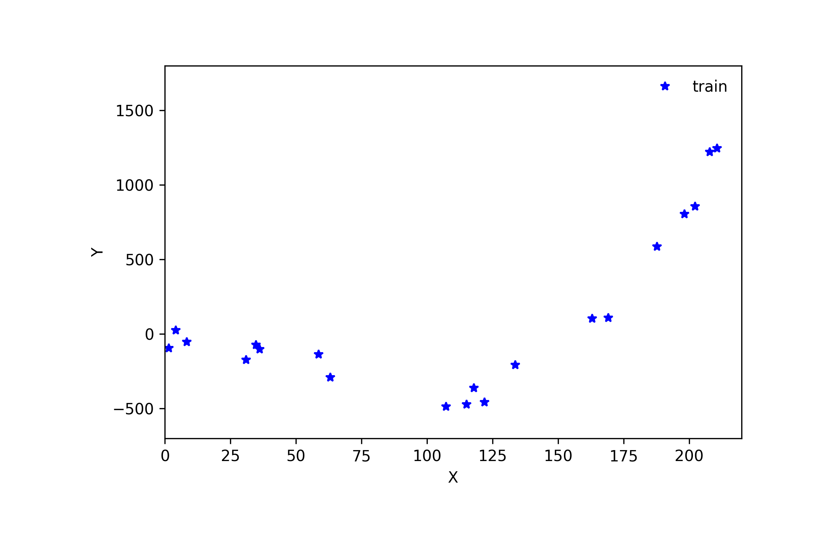
Cross Validation

Slide 27
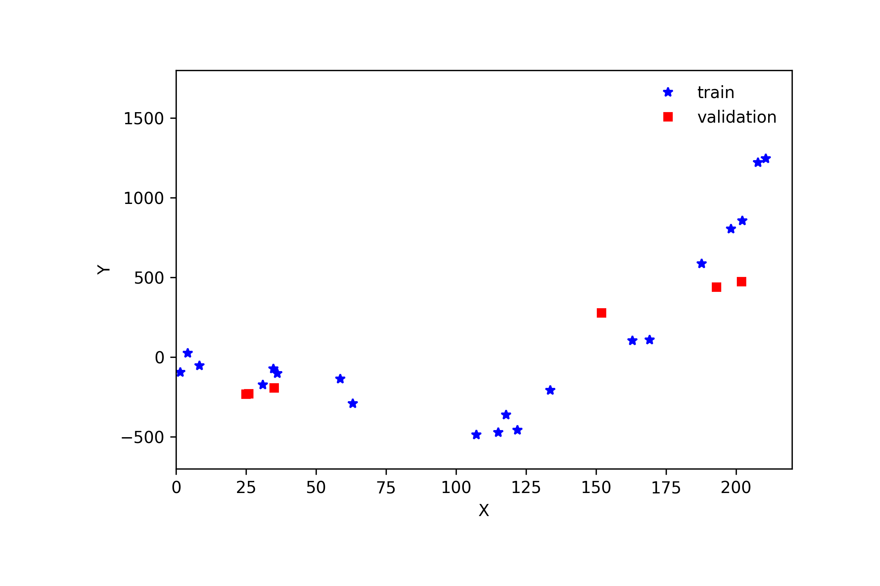
Cross Validation

Slide 28
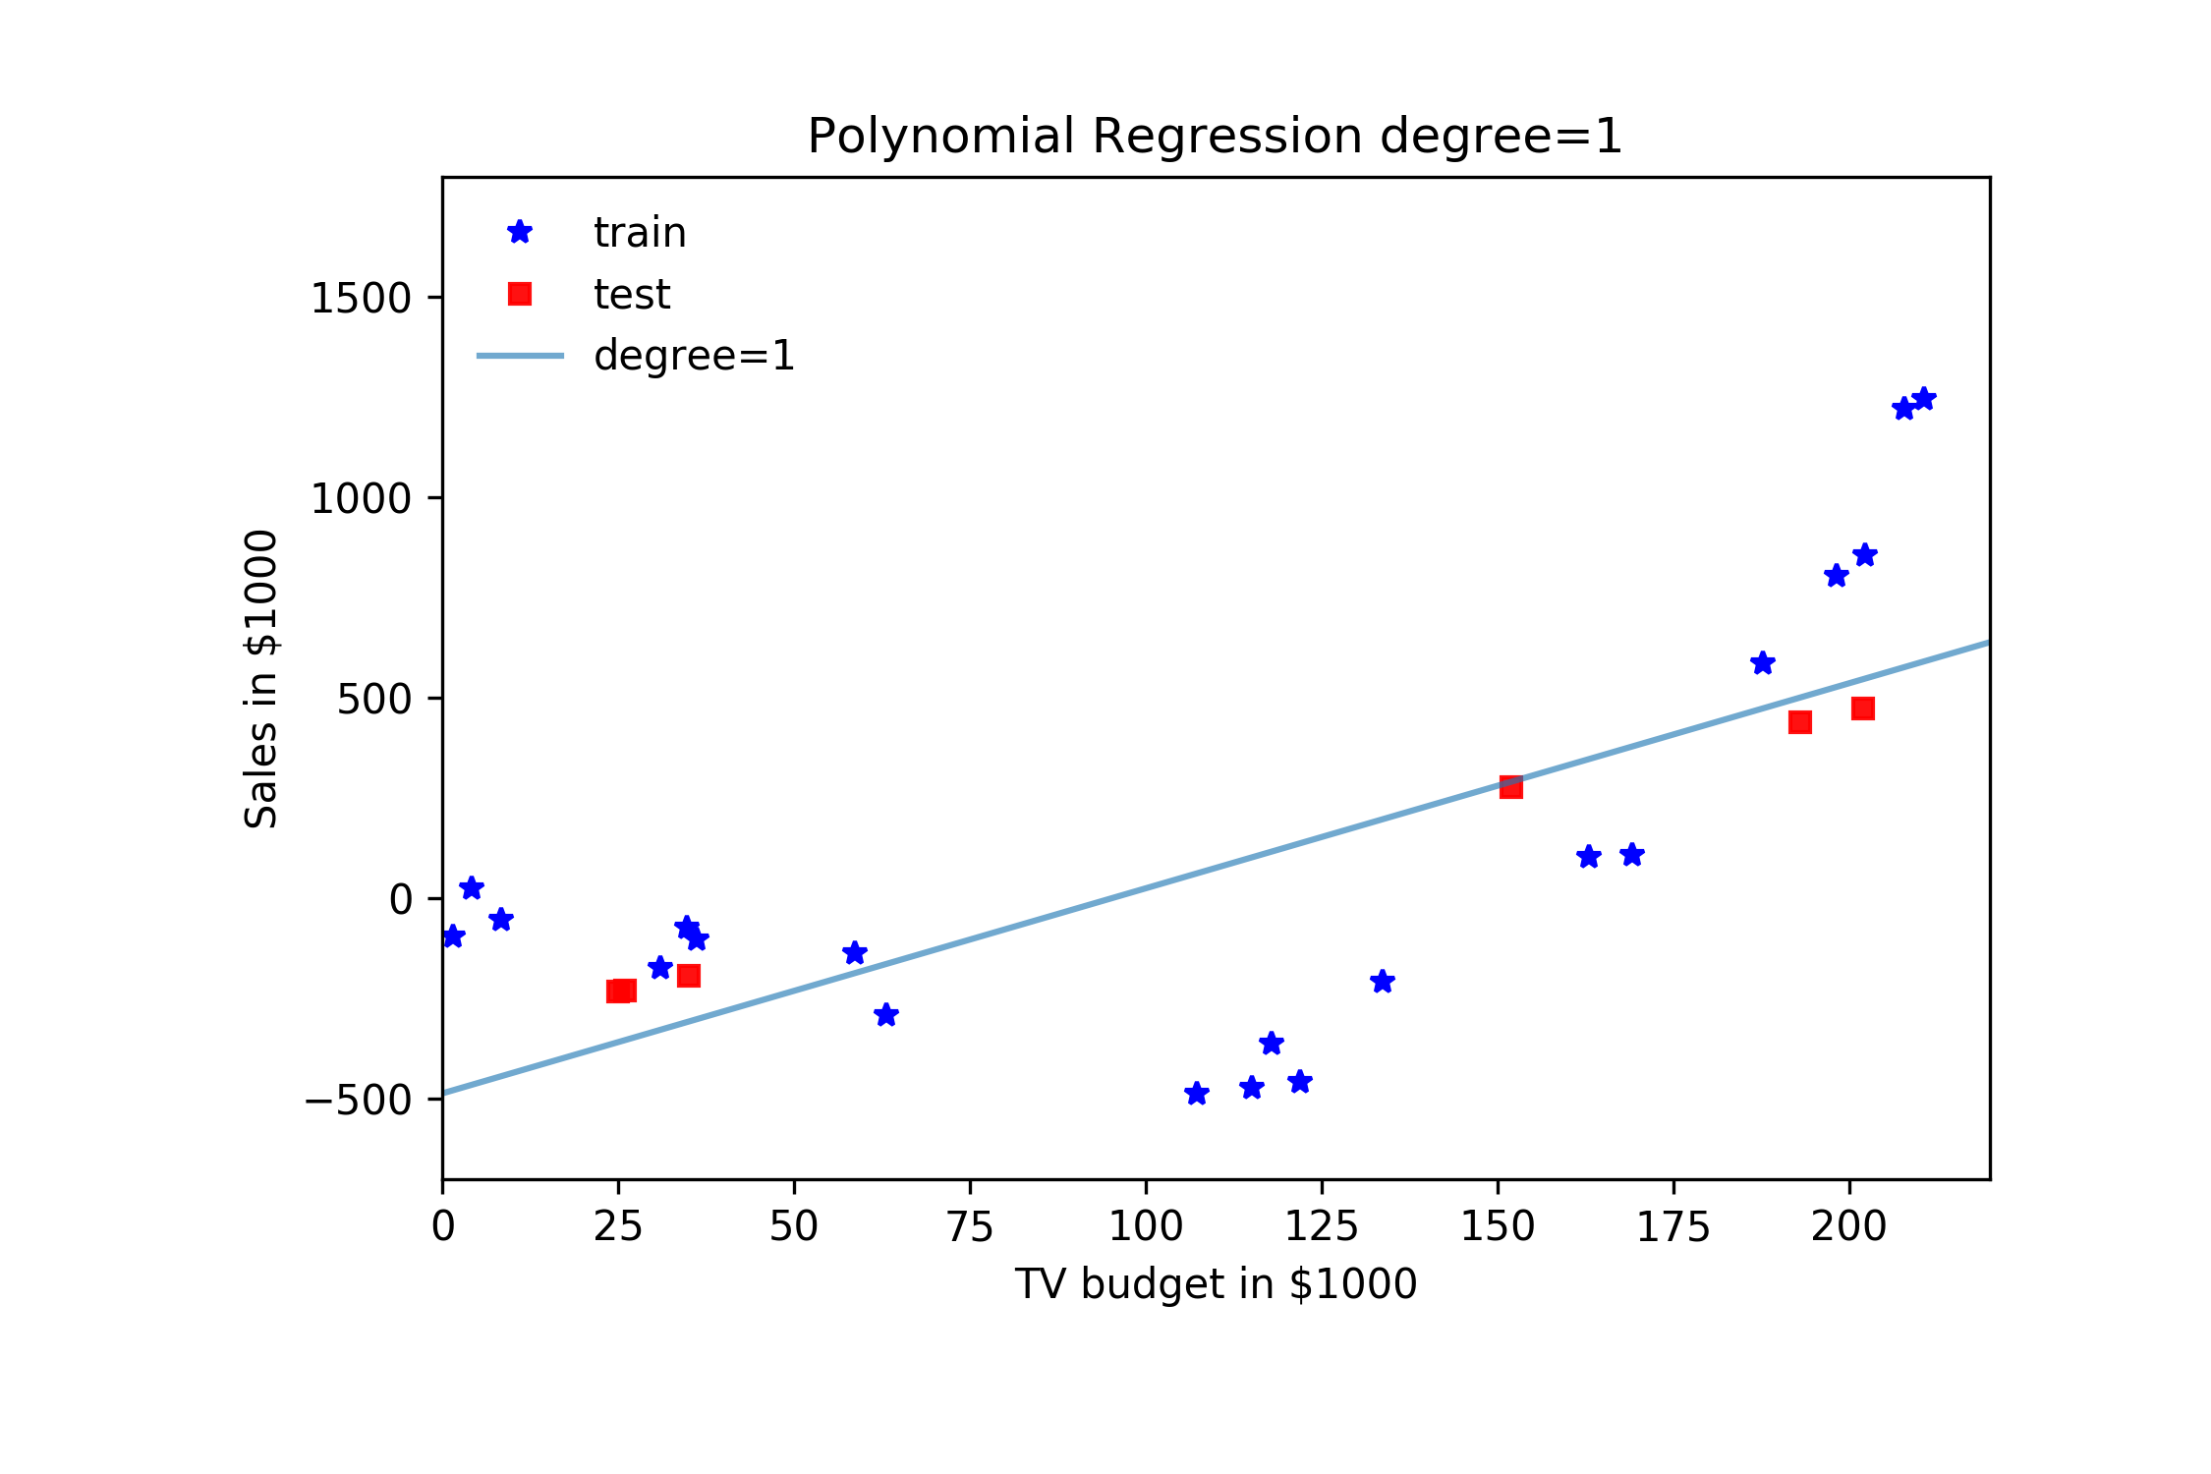
Cross Validation

Slide 29
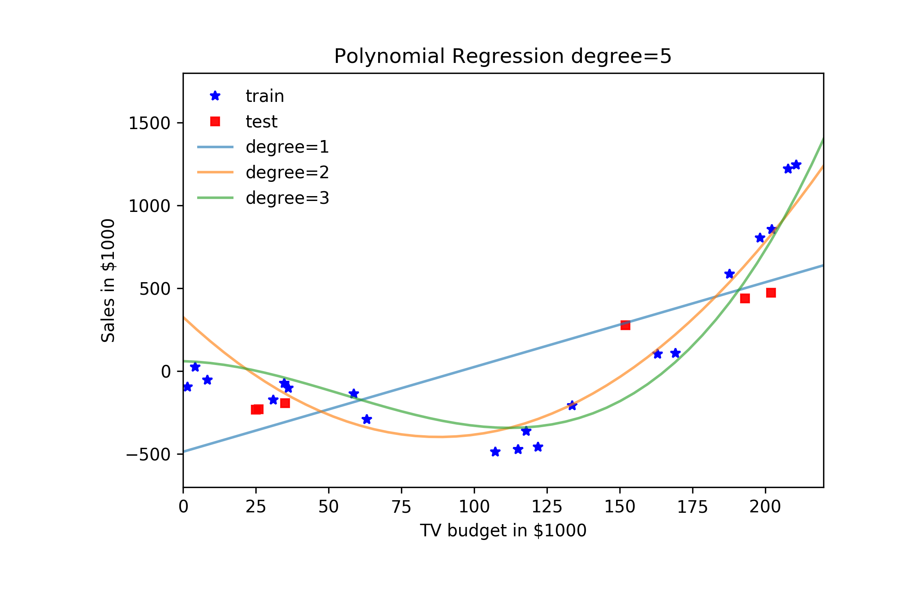
Cross Validation

Slide 30
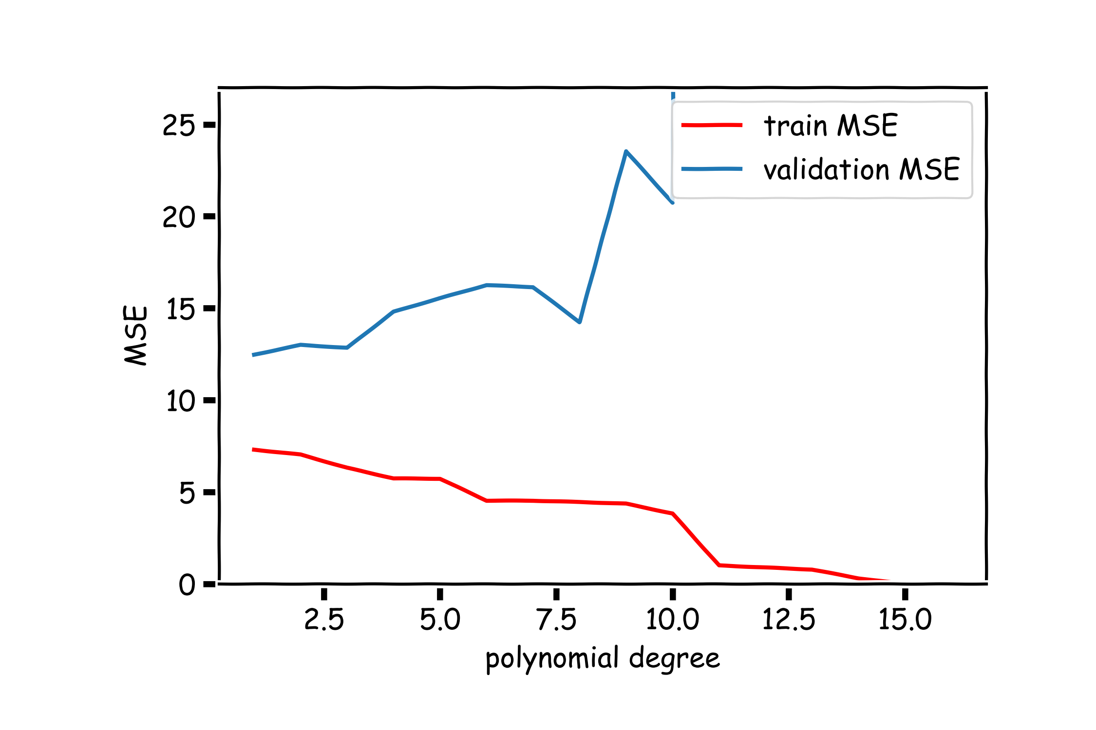
Validation

Slide 31
Cross Validation: Motivation
Using a single validation set to select amongst multiple models can be problematic - there is the possibility of overfitting to the validation set.
One solution to the problems raised by using a single validation set is to evaluate each model on multiple validation sets and average the validation performance.
One can randomly split the training set into training and validation multiple times but randomly creating these sets can create the scenario where important features of the data never appear in our random draws.

Slide 32
Cross Validation

Slide 33
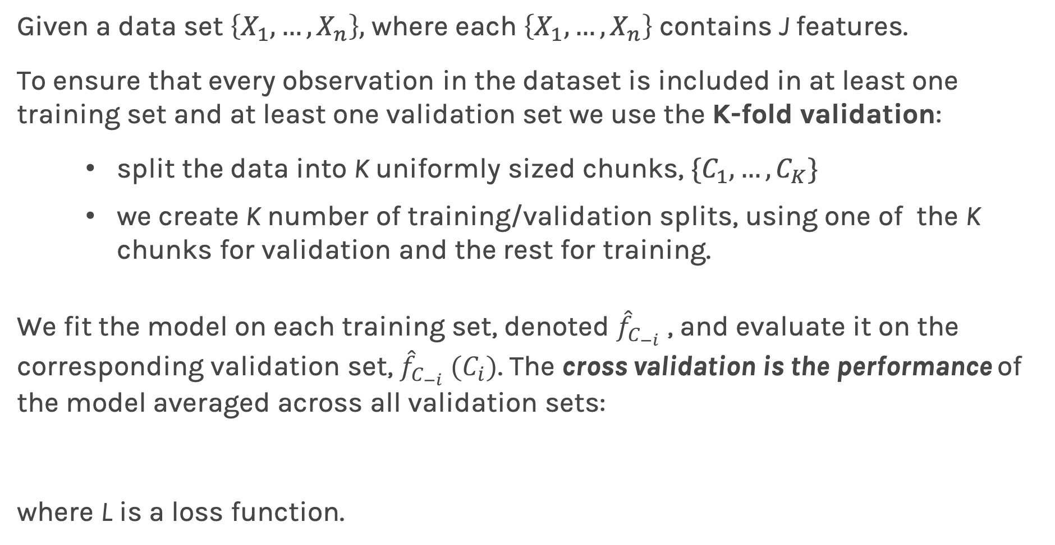
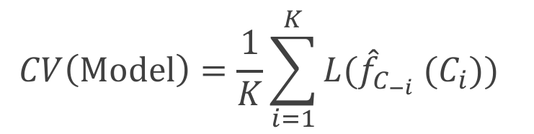
K-Fold Cross Validation
Given a data set $\left\{X_{1},…,X_{n}\right\},$ where each $\left\{X_{1},…,X_{n}\right\}$ contains J features.
To ensure that every observation in the dataset is included in at least one training set and at least one validation set we use the K-fold validation:
split the data into K uniformly sized chunks, $\{C_{1},…,C_{K}\}$
we create K number of training/validation splits, using one of the K chunks for validation and the rest for training.
We fit the model on each training set, denoted ${\hat{f}}_{C_{−i}}$ , and evaluate it on the corresponding validation set, ${\hat{f}}_{C_{−i}} (C_{i})$. The cross validation is the performance of the model averaged across all validation sets:
where L is a loss function.
$$CV\left(Model\right)=\frac{1}{K}\sum_{i=1}^{K}{{L(\hat{f}}_{C_{−i}} (C_{i})\text{)} }$$

Slide 34
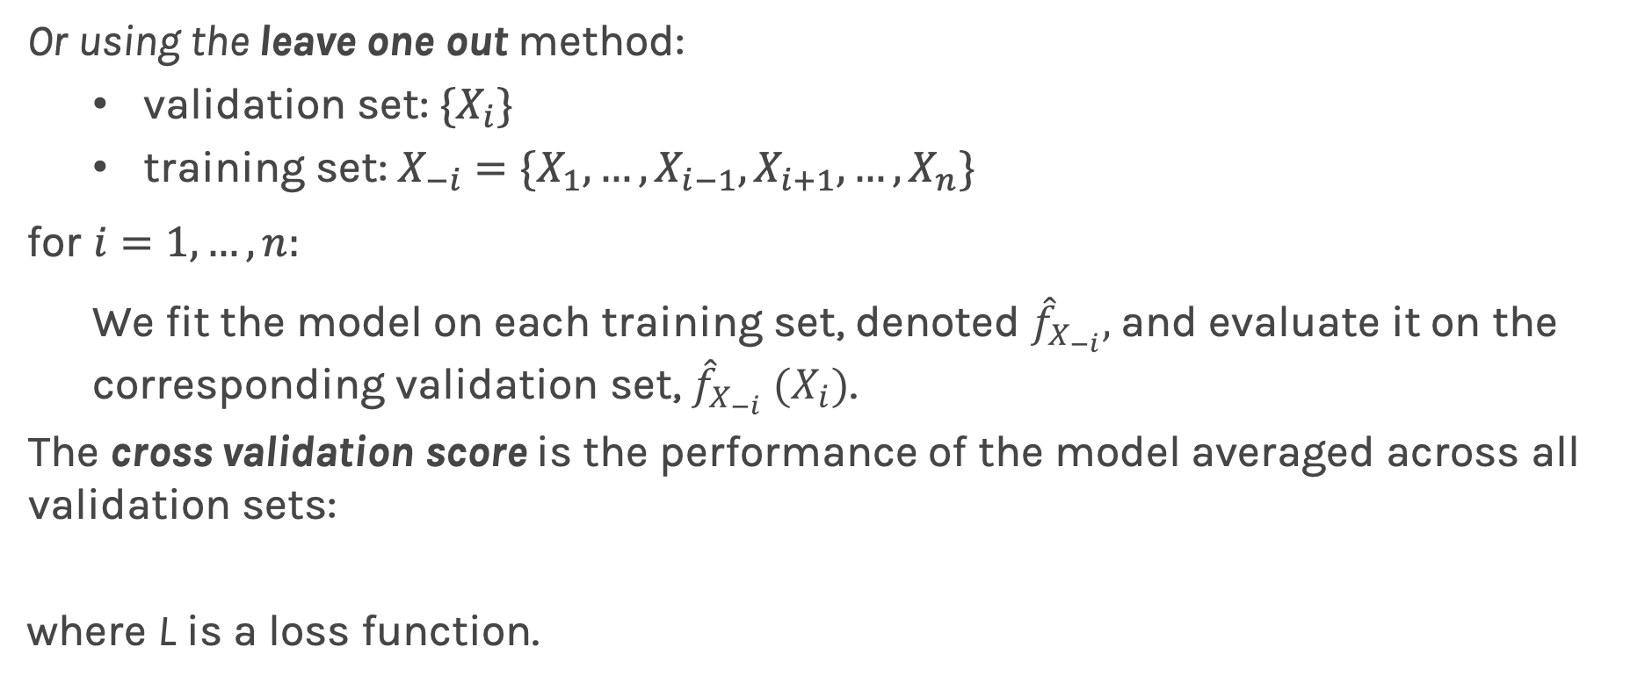
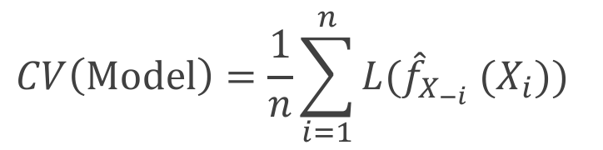
Leave-One-Out
Or using the leave one out method:
validation set: ${\{X}_{i}\}$
training set: $X_{−i}=\{X_{1}, …,X_{i−1},X_{i+1}, …, X_{n}\}$
for ${i=1,…,n: }_{}$
We fit the model on each training set, denoted ${\hat{f}}_{X_{−i}},$and evaluate it on the corresponding validation set, ${\hat{f}}_{X_{−i}} (X_{i})$.
The cross validation score is the performance of the model averaged across all validation sets:
where L is a loss function.
$$CV\left(Model\right)=\frac{1}{n}\sum_{i=1}^{n}{{L(\hat{f}}_{X_{−i}} (X_{i})\text{)} }$$

Slide 35
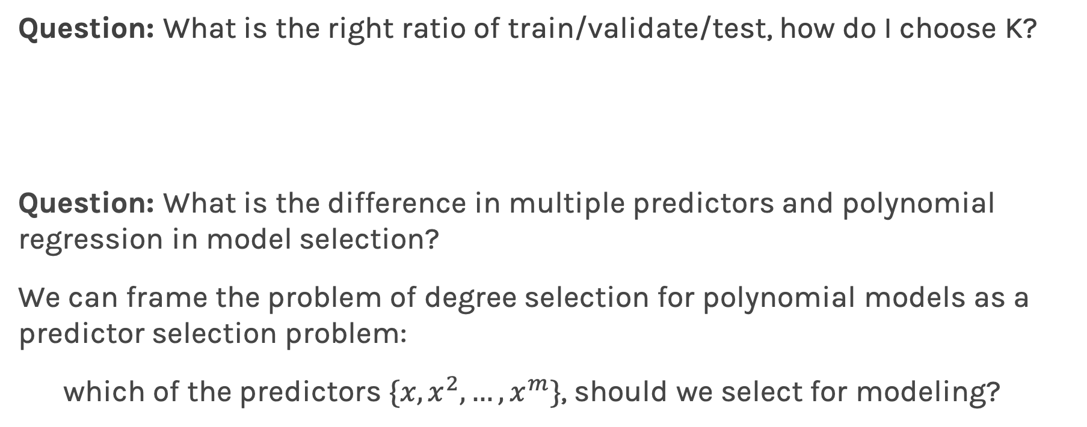
Predictor Selection: Cross Validation
Question: What is the right ratio of train/validate/test, how do I choose K?
Question: What is the difference in multiple predictors and polynomial regression in model selection?
We can frame the problem of degree selection for polynomial models as a predictor selection problem:
which of the predictors $\{x, x^{2},…, x^{m}\}$, should we select for modeling?

Slide 36

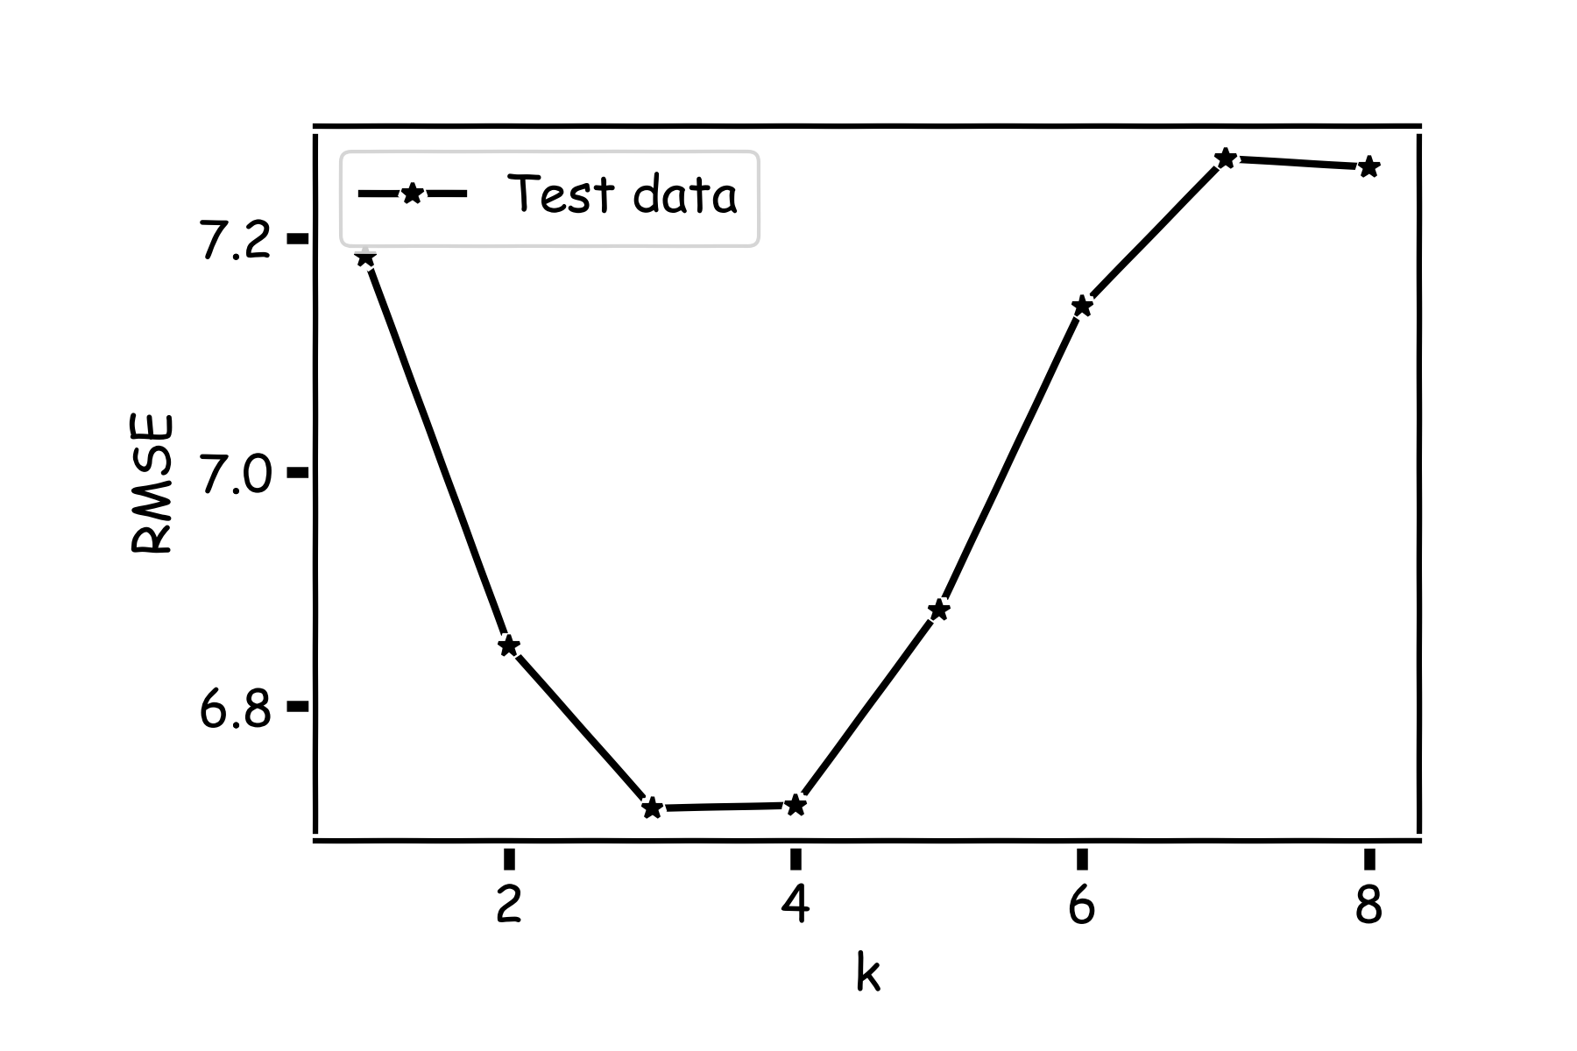
kNN Revisited

Slide 37
kNN Revisited
Recall our first simple, intuitive,
non-parametric model for regression –
the kNN model. We saw that it is vitally
important to select an appropriate k for
the data.
If the k is too small then the model is very sensitive to noise (since a new prediction is based on very few observed neighbors), and if the k is too large, the model tends towards making constant predictions.
A principled way to choose k is through K-fold cross validation.

Slide 38
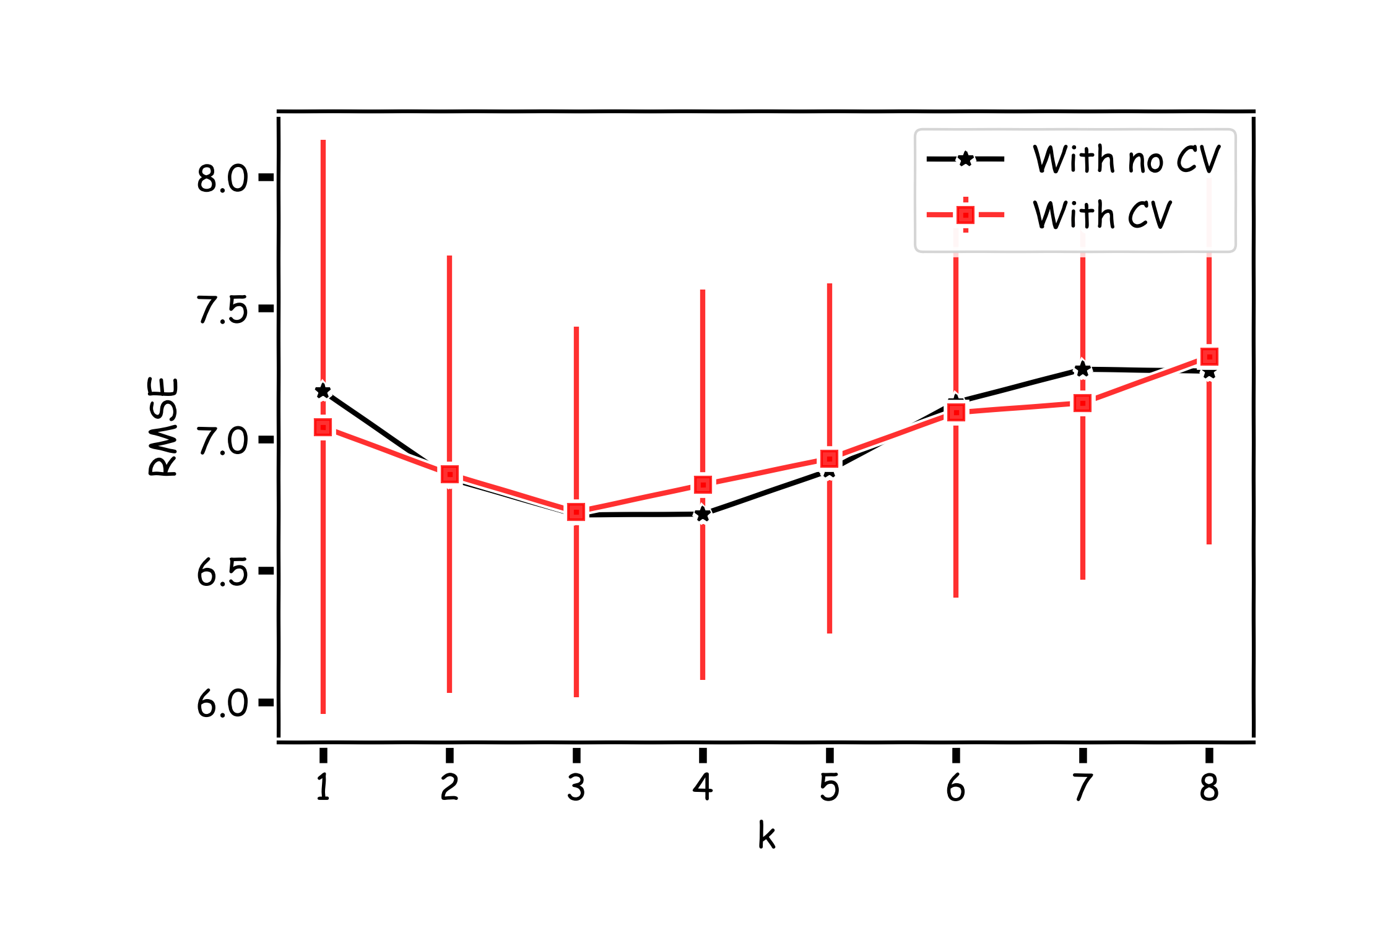
K-fold with k=100

Slide 39
Lecture Outline
Overfitting
Model Selection
Cross Validation
Bias vs Variance
Regularization: LASSO and Ridge
Regularization Methods: A Comparison

Slide 40


Slide 41
Bias vs Variance

Slide 44
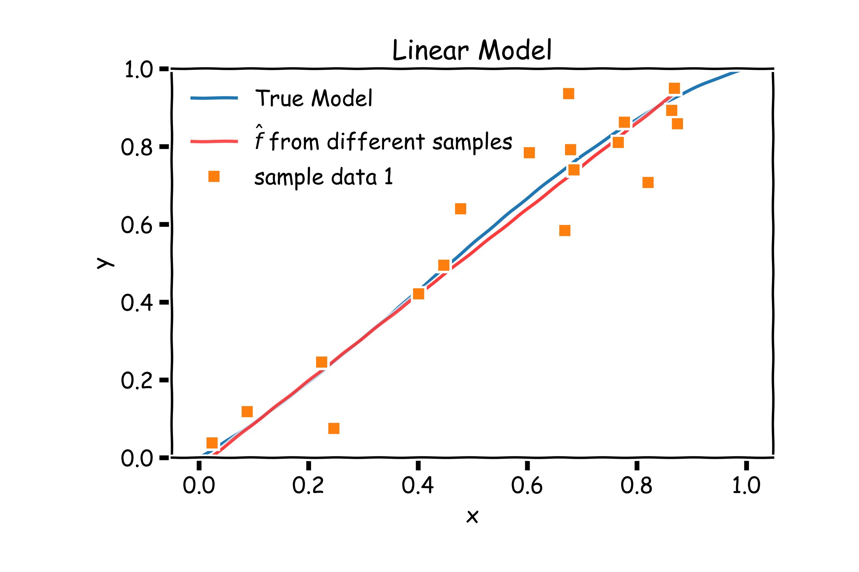
Bias vs Variance

Slide 45
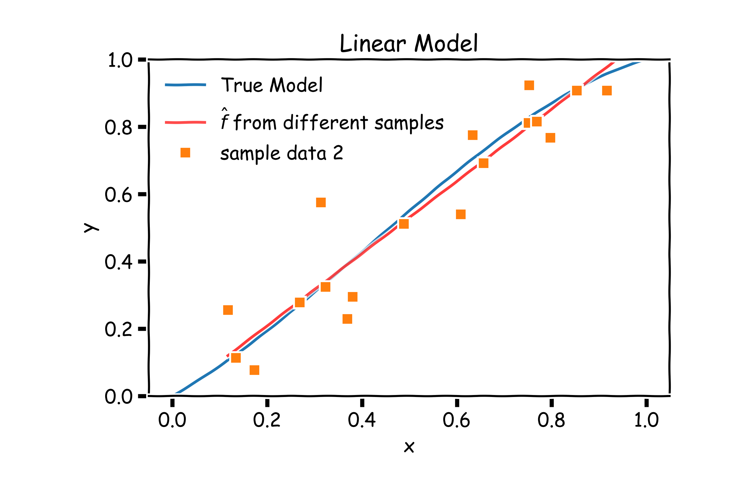
Bias vs Variance

Slide 46
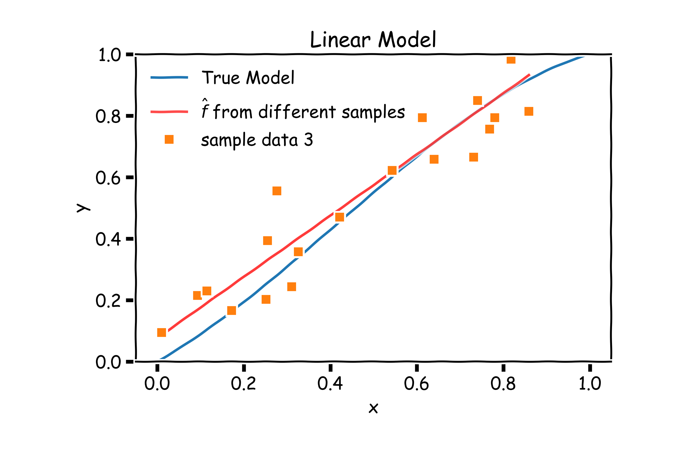
Bias vs Variance

Slide 47
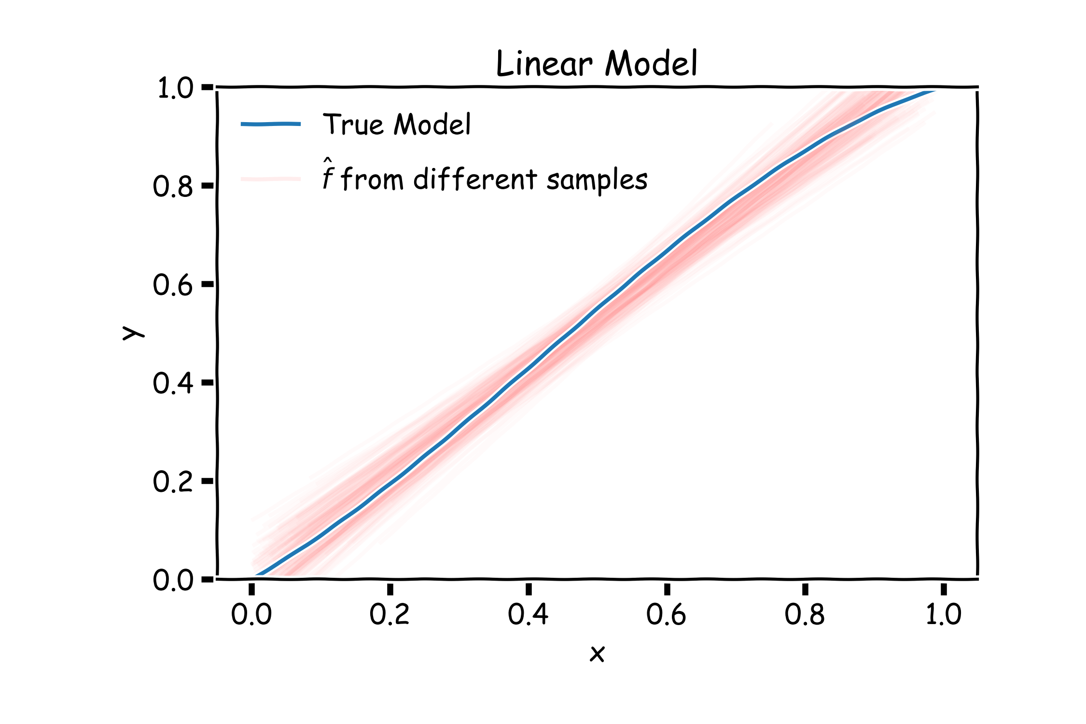
Linear models: 20 data points per line 2000 simulations

Slide 48
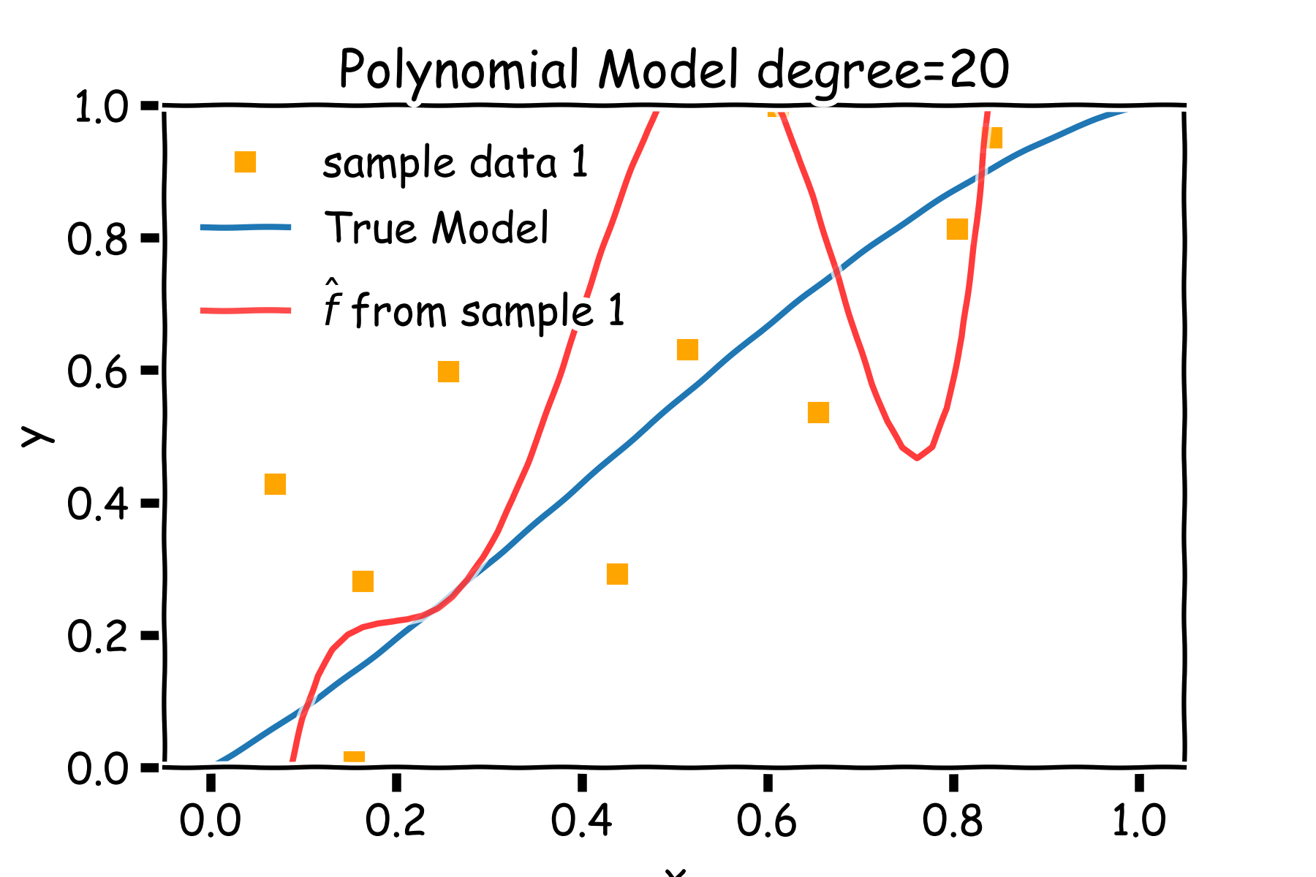
Bias vs Variance

Slide 49
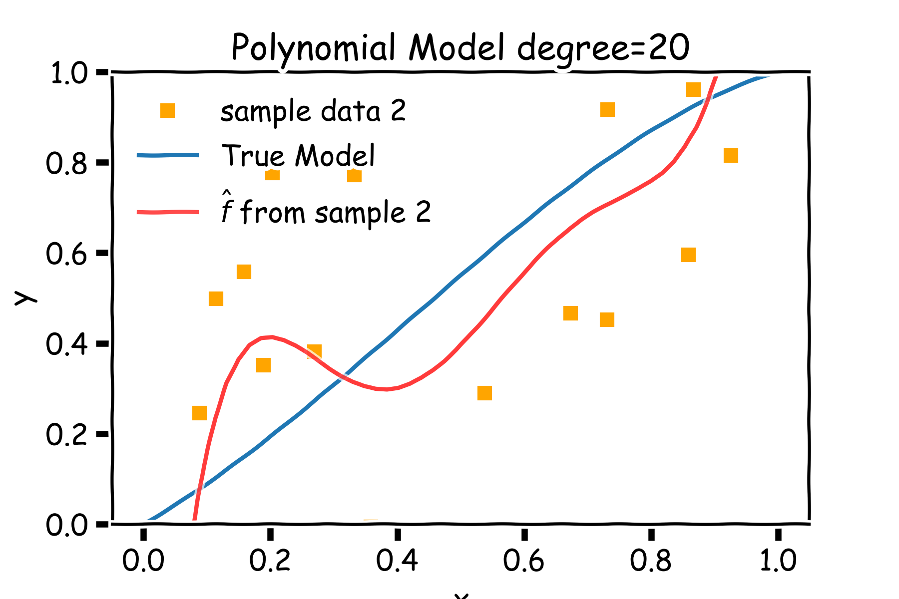
Bias vs Variance

Slide 50
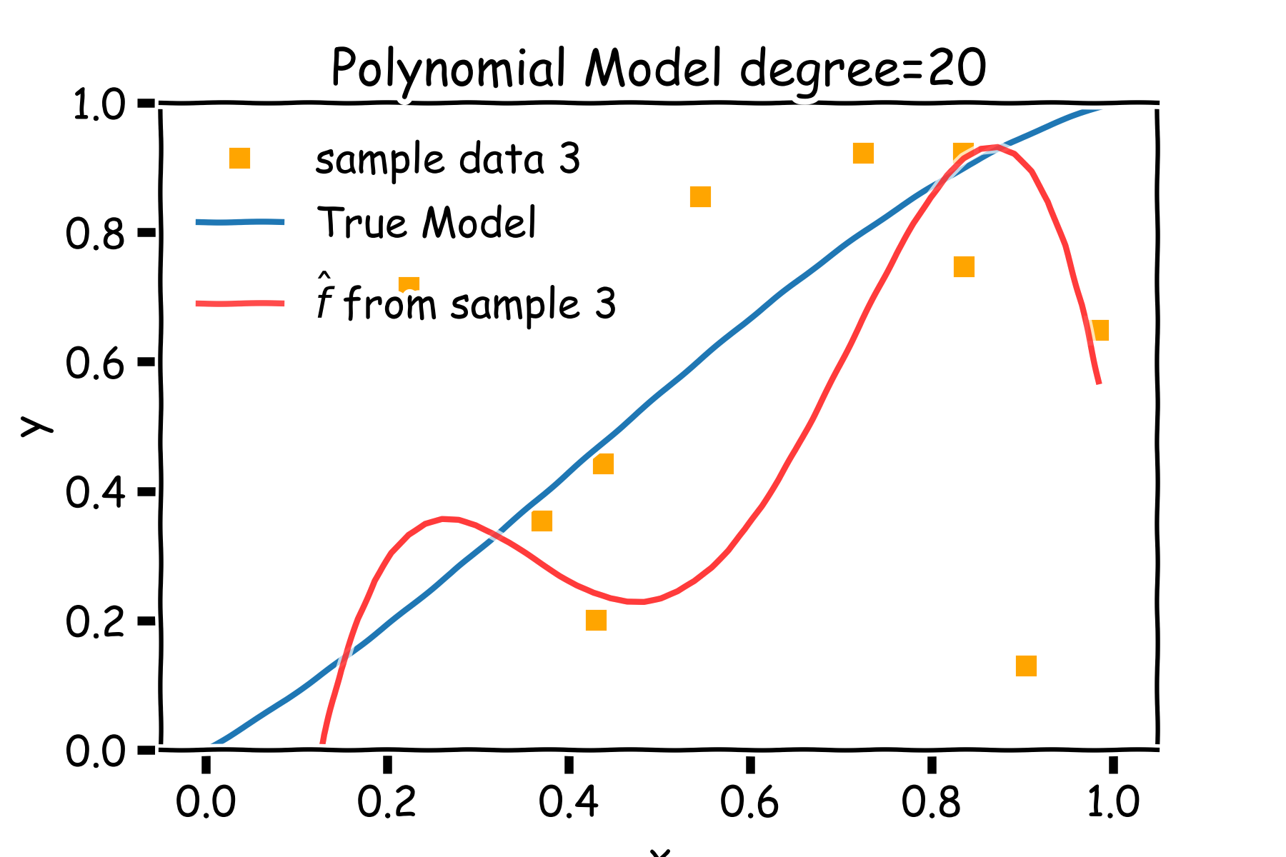
Bias vs Variance

Slide 51
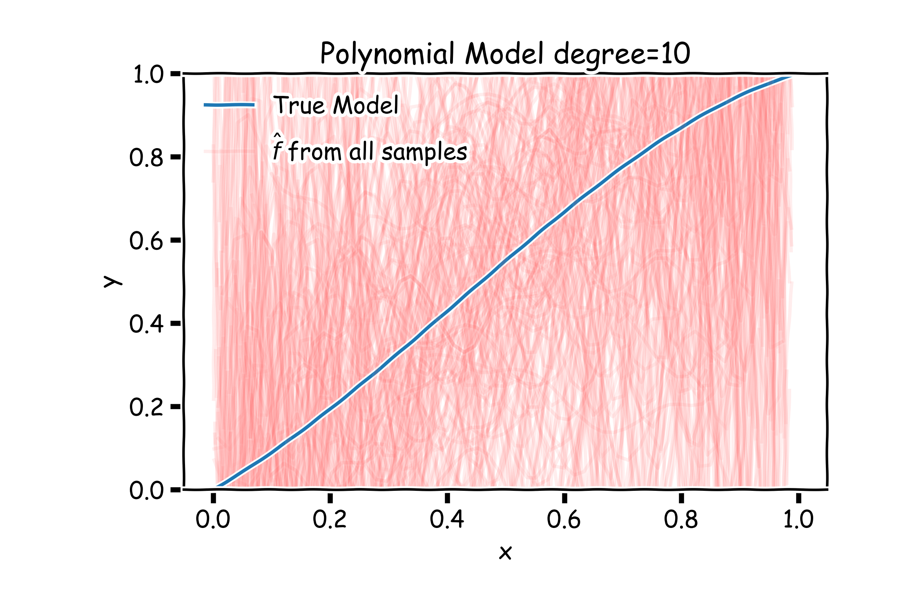
Poly 10 degree models : 20 data points per line 2000 simulations

Slide 52
Bias vs Variance
Left: 2000 best fit straight lines, each fitted on a different 20 point training set.
Right: Best-fit models using degree 10 polynomial

Slide 53
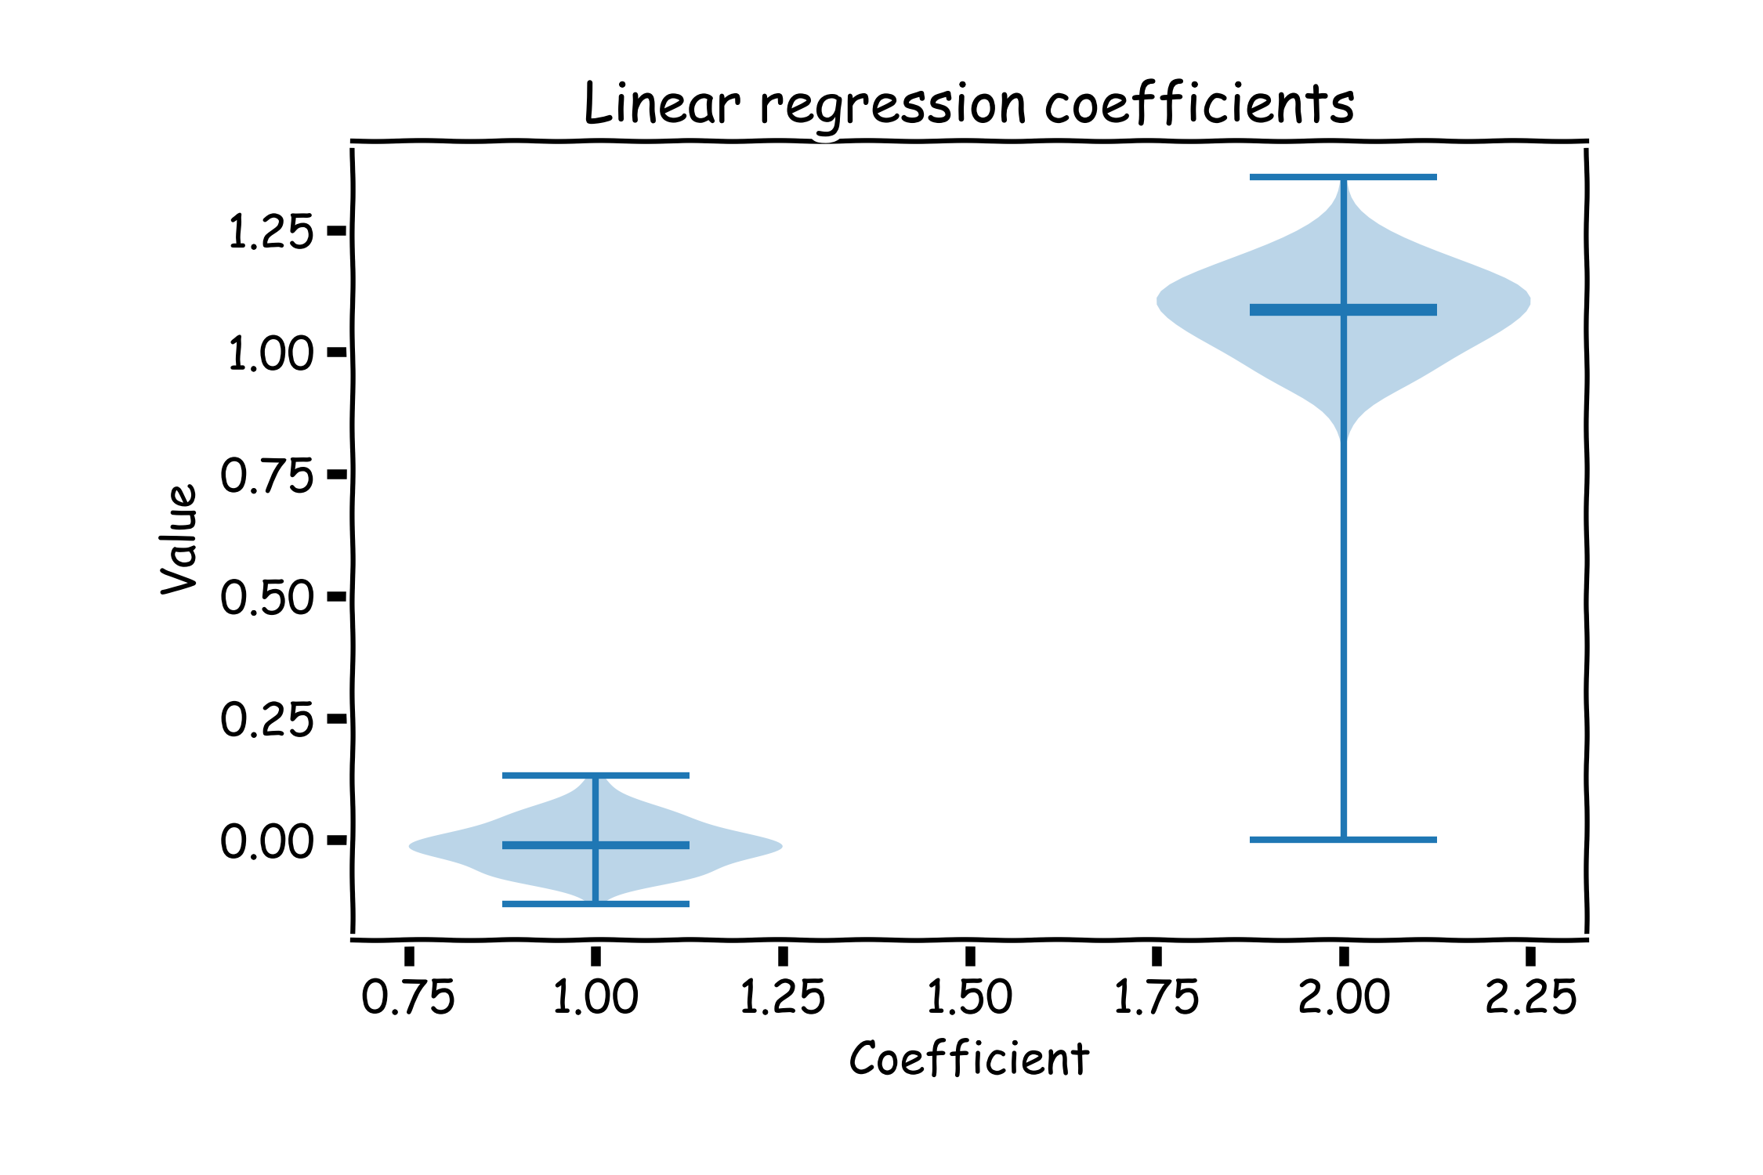
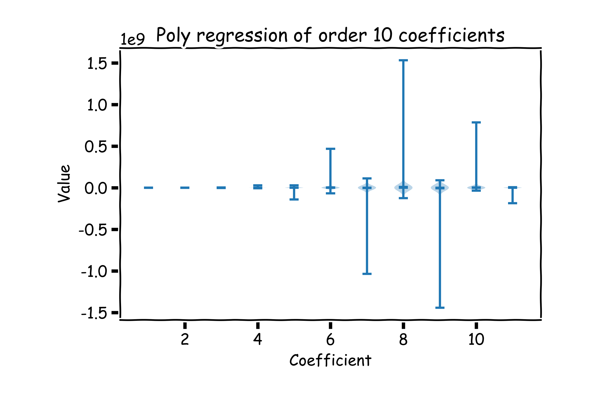
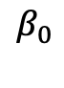
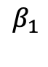
Bias vs Variance
Left: Linear regression coefficients
Right: Poly regression of order 10 coefficients
$$β_{0}$$
$$β_{1}$$

Slide 54
Lecture Outline
Overfitting
Model Selection
Cross Validation
Bias vs Variance
Regularization: LASSO and Ridge
Regularization Methods: A Comparison

Slide 55
Regularization: LASSO and Ridge

Slide 56
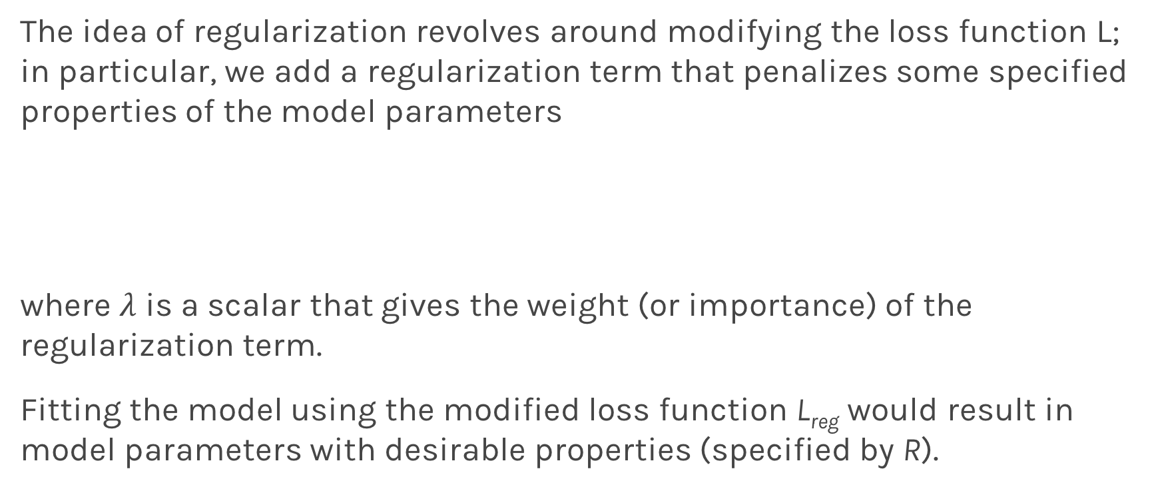
Regularization: An Overview
The idea of regularization revolves around modifying the loss function L; in particular, we add a regularization term that penalizes some specified properties of the model parameters
where $λ$ is a scalar that gives the weight (or importance) of the regularization term.
Fitting the model using the modified loss function L_{reg} would result in model parameters with desirable properties (specified by R).

Slide 57
LASSO Regression
Since we wish to discourage extreme values in model parameter, we need to choose a regularization term that penalizes parameter magnitudes. For our loss function, we will again use MSE.
Together our regularized loss function is:
Note that is the l₁ norm of the vector β

Slide 58
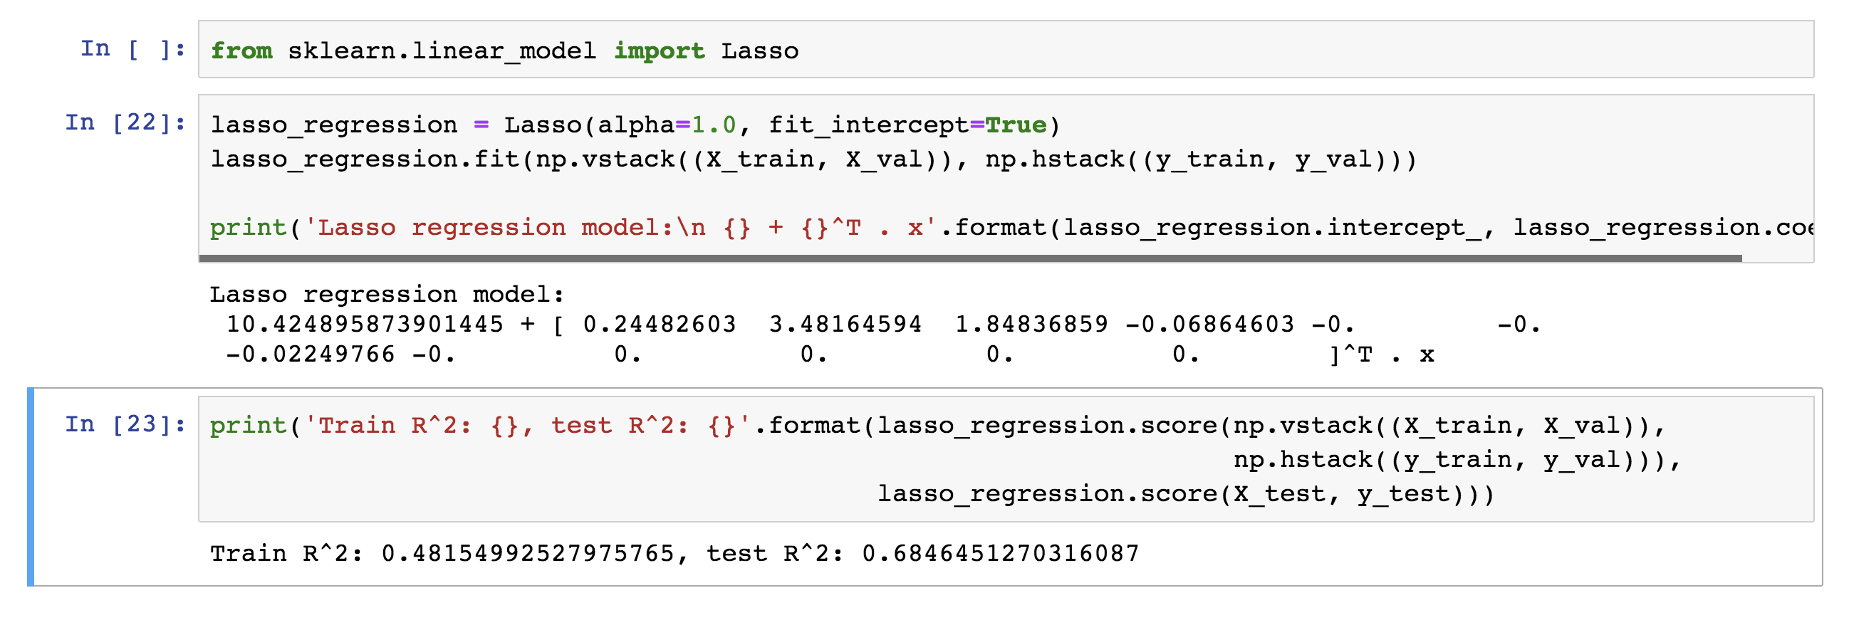
LASSO Regression
Hence, we often say that L_{LASSO} is the loss function for l₁ regularization.
Finding the model parameters β_{LASSO} that minimize the l₁ regularized loss function is called LASSO regression.

Slide 59
Ridge Regression
Alternatively, we can choose a regularization term that penalizes the squares of the parameter magnitudes. Then, our regularized loss function is:
Note that is the l₂ norm of the vector β

Slide 60
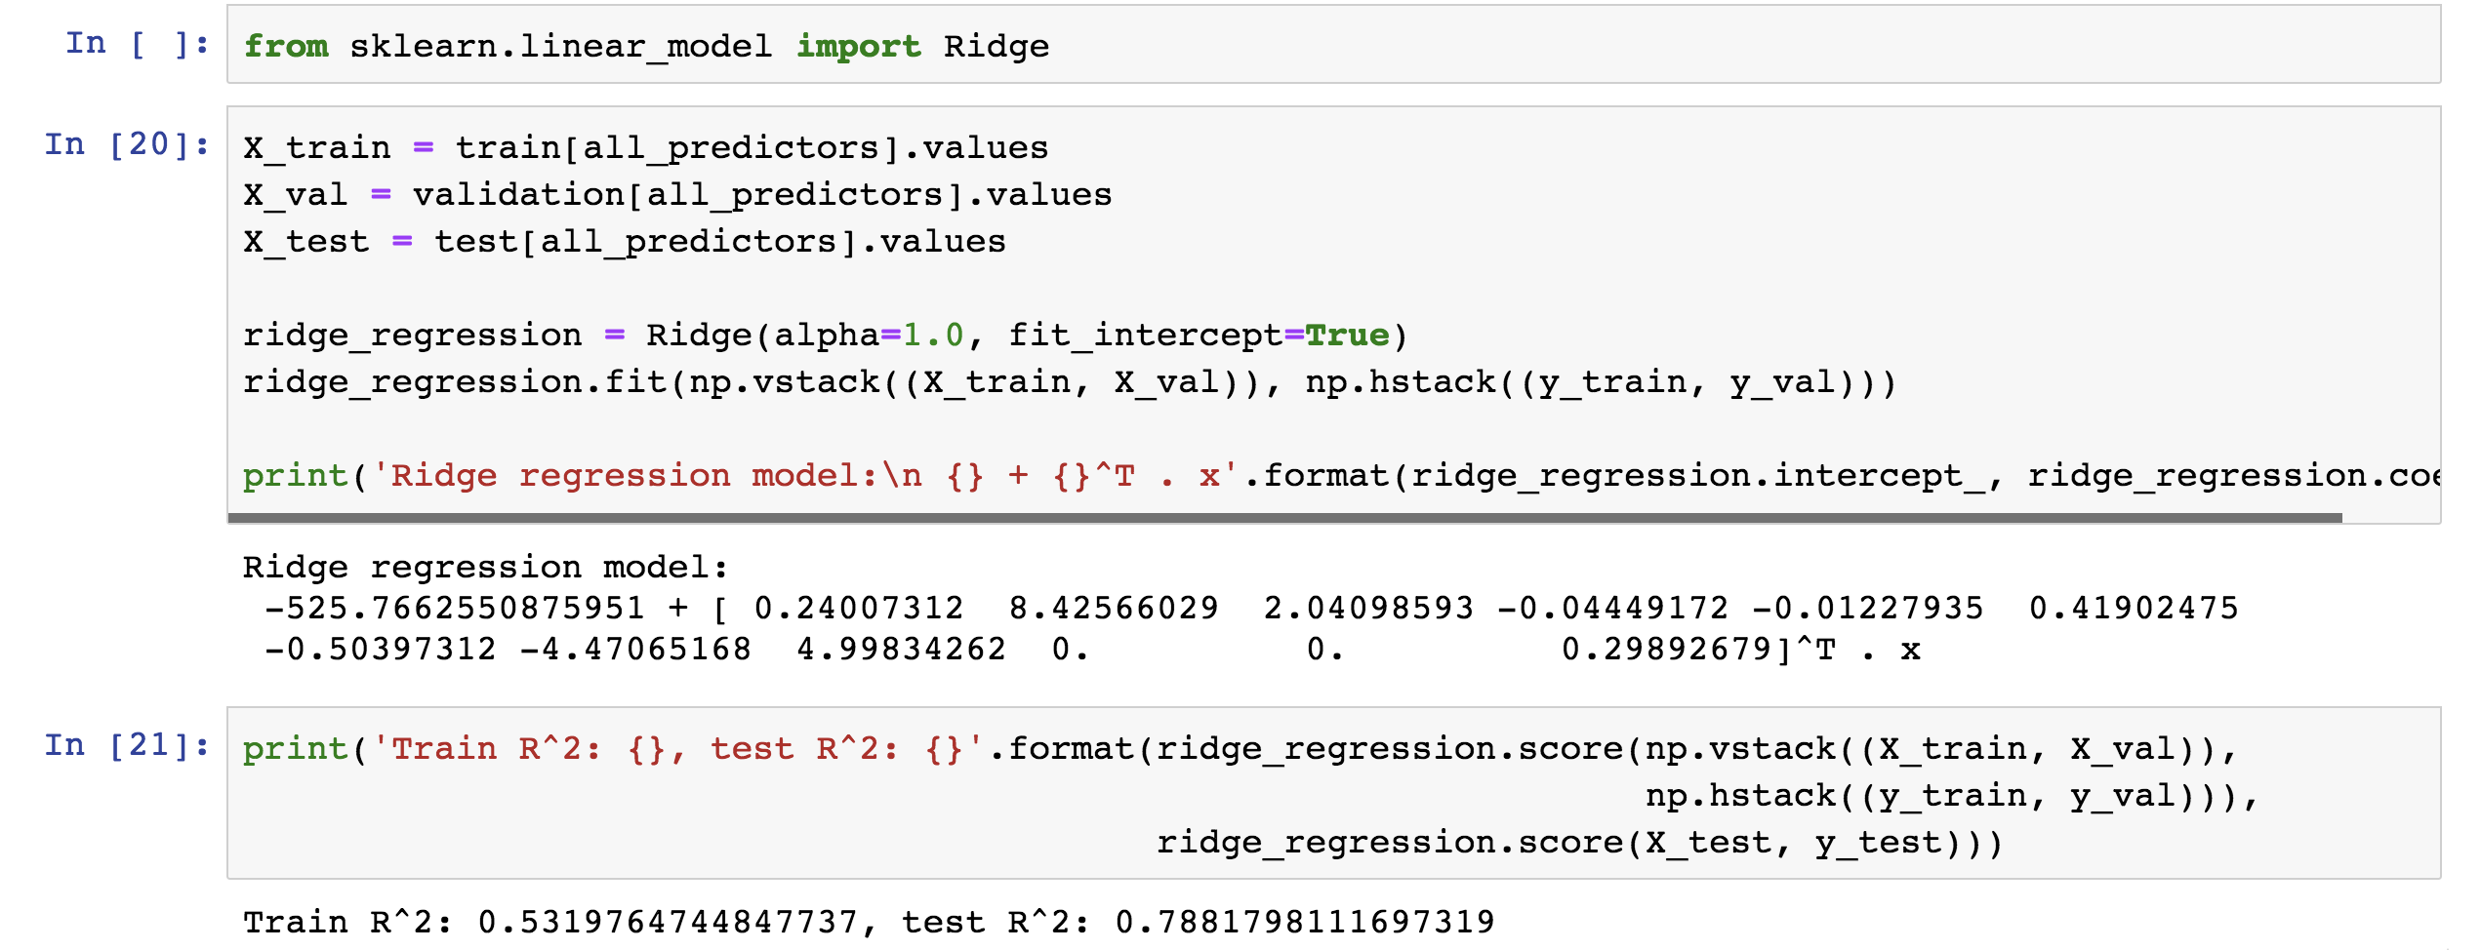
Ridge Regression
Hence, we often say that L_{ridge} is the loss function for l₂ regularization.
Finding the model parameters β_{ridge} that minimize the l₂ regularized loss function is called ridge regression.

Slide 61
Choosing λ
In both ridge and LASSO regression, we see that the larger our choice of the regularization parameter λ, the more heavily we penalize large values in β,
If λ is close to zero, we recover the MSE, i.e. ridge and LASSO regression is just ordinary regression.
If λ is sufficiently large, the MSE term in the regularized loss function will be insignificant and the regularization term will force β_{ridge} and β_{LASSO} to be close to zero.
To avoid ad-hoc choices, we should select λ using cross-validation.

Slide 62
Ridge - Computational complexity
Solution to ridge regression:
The solution of the Ridge/Lasso regression involves three steps
Select λ
Find the minimum of the ridge/Lasso regression cost function (using linear algebra) as with the multiple regression and record the R² on the test set.
Find the λ that gives the largest R²

Slide 63
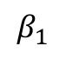
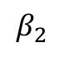
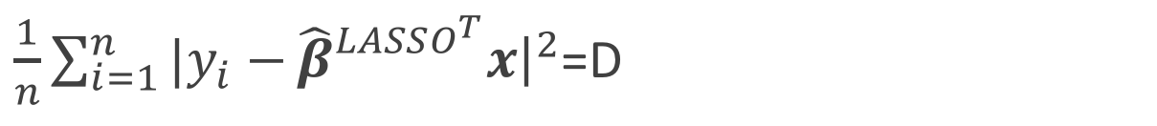
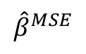
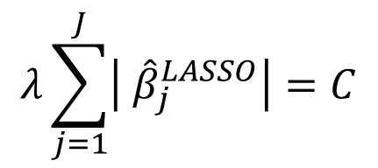
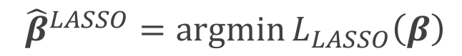
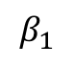
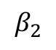
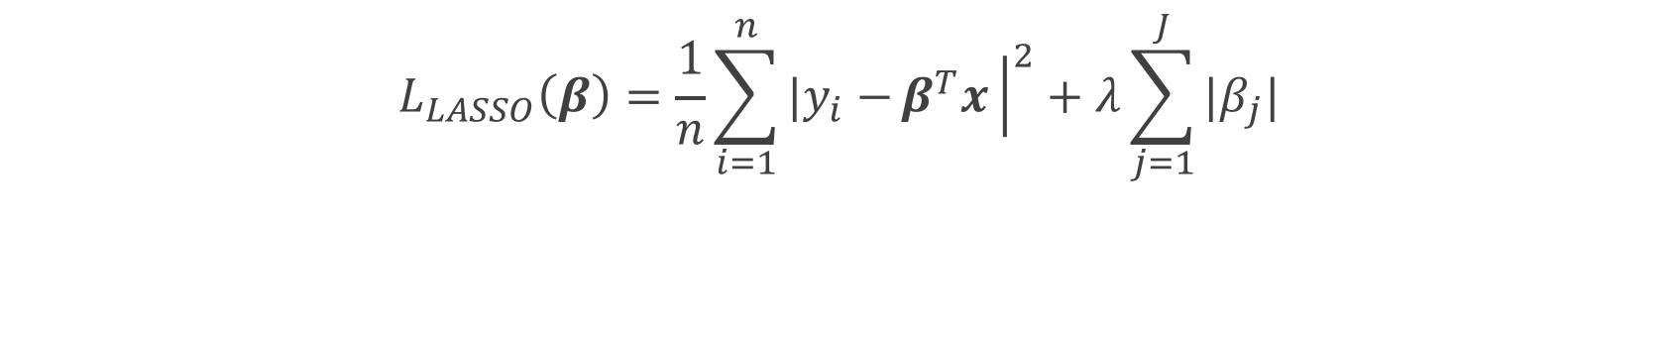
The Geometry of Regularization (LASSO)
$$L_{LASSO}\left(β\right)=\frac{1}{n}\sum_{i=1}^{n}{|y_{i}−}β^{T}x{\left.​\right|}^{2}+λ\sum_{j=1}^{J}{|β_{j}|}$$
$${\hat{β}}^{LASSO}=argmin{L_{LASSO}\left(β\right)}$$
$$λ\sum_{j=1}^{J}{\left| {\hat{β}}_{j}^{LASSO}\right|=C}$$
$\frac{1}{n}\sum_{i=1}^{n}{|y_{i}−}{\hat{β}}_{}^{LASSO^{T}}x{\left.​\right|}^{2}$=D
$$β_{2}$$
$$β_{2}$$
C
$${\hat{β}}^{MSE}$$
MSE=D
C
$$β_{1}$$
$$β_{1}$$

Slide 64
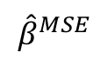
The Geometry of Regularization (LASSO)
$$β_{2}$$
$$β_{2}$$
$$β_{2}$$
$${\hat{β}}^{MSE}$$
MSE=D
C
C
$${\hat{β}}^{MSE}$$
MSE=D
C
C
$$β_{1}$$
$$β_{1}$$
$$β_{1}$$

Slide 65
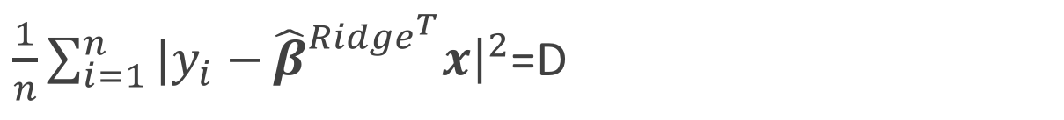
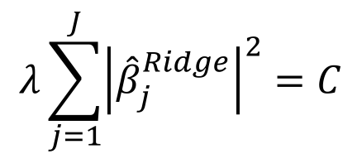



The Geometry of Regularization (Ridge)
$$L_{Ridge}\left(β\right)=\frac{1}{n}\sum_{i=1}^{n}{|y_{i}−}β^{T}x{\left.​\right|}^{2}+λ\sum_{j=1}^{J}{{\left(β_{j}\right)}^{2}}$$
$${\hat{β}}^{Ridge}=argmin{L_{Ridge}\left(β\right)}$$
$$λ\sum_{j=1}^{J}{{\left|{\hat{β}}_{j}^{Ridge}\right|}^{2}=C}$$
$\frac{1}{n}\sum_{i=1}^{n}{|y_{i}−}{\hat{β}}_{}^{{Ridge}^{T}}x{\left.​\right|}^{2}$=D
$$β_{2}$$
$$β_{2}$$
$${\hat{β}}^{MSE}$$
MSE=D
C
$$β_{1}$$
$$β_{1}$$

Slide 66

The Geometry of Regularization (Ridge)
$$β_{2}$$
$${\hat{β}}^{MSE}$$
MSE=D
C
$$β_{1}$$

Slide 67


The Geometry of Regularization
$$β_{2}$$
$$β_{2}$$
$${\hat{β}}^{MSE}$$
MSE=D
$${\hat{β}}^{MSE}$$
MSE=D
C
C
C
$$β_{1}$$
$$β_{1}$$

Slide 68

Ridge regularization with validation only: step by step
split data into $\{{\left\{X,Y\right\}}_{train},{\left\{X,Y\right\}}_{validation},{\left\{X,Y\right\}}_{test}\}$
for $λ in \left\{λ_{min},…λ_{max}\right\}:$
determine the $β$ that minimizes the $L_{ridge}$, ${\hat{β}}_{Ridge}\left(λ\right)={\left(X^{T}X+λI\right)}^{−1}X^{T}Y$ , using the train data.
record $L_{MSE}^{}\left(λ\right)$ using validation data.
select the $λ$that minimizes the loss on the validation data, $λ_{ridge}={argmin}_{λ} L_{MSE}^{}\left(λ\right)$
Refit the model using both train and validation data, $\{{\left\{X,Y\right\}}_{train},{\left\{X,Y\right\}}_{validation}$ }, resulting to ${\hat{β}}_{ridge}\left(λ_{ridge}\right)$
report MSE or R² on ${\left\{X,Y\right\}}_{test}$ given the ${\hat{β}}_{ridge}\left(λ_{ridge}\right)$

Slide 69

Ridge regularization with validation only: step by step

Slide 70

Lasso regularization with validation only: step by step
split data into $\{{\left\{X,Y\right\}}_{train},{\left\{X,Y\right\}}_{validation},{\left\{X,Y\right\}}_{test}\}$
for $λ in \left\{λ_{min},…λ_{max}\right\}:$
determine the $β$ that minimizes the $L_{lasso}$, ${\hat{β}}_{lasso}\left(λ\right)$, using the train data. This is done using a solver.
record $L_{MSE}^{}\left(λ\right)$ using validation data
select the $λ$that minimizes the loss on the validation data, ${ λ}_{lasso}={argmin}_{λ} L_{MSE}^{}\left(λ\right)$
Refit the model using both train and validation data, $\{{\left\{X,Y\right\}}_{train},{\left\{X,Y\right\}}_{validation}$ }, resulting to ${\hat{β}}_{lasso}\left(λ_{lasso}\right)$
report MSE or R² on ${\left\{X,Y\right\}}_{test}$ given the ${\hat{β}}_{lasso}\left(λ_{lasso}\right)$

Slide 71








Ridge regularization with CV: step by step
 | $$λ_{1}$$ | $$λ_{2}$$ | … | $$λ_{n}$$
$$k_{1}$$
$$k_{2}$$
…
$$k_{n}$$
 | $$λ_{1}$$ | $$λ_{2}$$ | … | $$λ_{n}$$
$$k_{1}$$ | $$L_{11}$$ | $$L_{12}$$ | .. | …
$$k_{2}$$ | $$L_{21}$$ | … | .. | …
… | .. | … | .. | …
$$k_{n}$$ | … | … | … | …
E[] | $${\overline{L}}_{1}$$ | $${\overline{L}}_{2}$$ | … | $${\overline{L}}_{n}$$
 | $$λ_{1}$$ | $$λ_{2}$$ | … | $$λ_{n}$$
$$k_{1}$$
$$k_{2}$$
…
$$k_{n}$$
 | $$λ_{1}$$ | $$λ_{2}$$ | … | $$λ_{n}$$
$$k_{1}$$ | $$L_{11}$$ | $$L_{12}$$ | .. | …
$$k_{2}$$ | $$L_{21}$$ | … | .. | …
… | .. | … | .. | …
$$k_{n}$$ | … | … | … | …
 | $$λ_{1}$$ | $$λ_{2}$$ | … | $$λ_{n}$$
$$k_{1}$$ | $$L_{11}$$
$$k_{2}$$
…
$$k_{n}$$
 | $$λ_{1}$$ | $$λ_{2}$$ | … | $$λ_{n}$$
$$k_{1}$$ | $$L_{11}$$ | $$L_{12}$$ | .. | …
$$k_{2}$$ | $$L_{21}$$ | … | .. | …
… | .. | … | .. | …
$$k_{n}$$ | … | … | … | …
E[] | $${\overline{L}}_{1}$$ | $${\overline{L}}_{2}$$ | … | $${\overline{L}}_{n}$$
 | $$λ_{1}$$ | $$λ_{2}$$ | … | $$λ_{n}$$
$$k_{1}$$
$$k_{2}$$
…
$$k_{n}$$
remove ${\left\{X,Y\right\}}_{test}$ from data
split the rest of data into K folds, $\{{\left\{X,Y\right\}}_{train}^{−k},{\left\{X,Y\right\}}_{val}^{k}\}$
for k in $\left\{1,…,K\right\}$
for $λ in \left\{λ_{0,}…{, λ}_{n}\right\}:$
determine the $β$ that minimizes the $L_{ridge}$, ${\hat{β}}_{ridge}\left(λ,k\right)={\left(X^{T}X+λI\right)}^{−1}X^{T}Y$ , using the train data of the fold, ${\left\{X,Y\right\}}_{train}^{−k}$.
record $L_{MSE}^{}\left(λ,k\right)$ using the validation data of the fold ${\left\{X,Y\right\}}_{val}^{k}$
At this point we have a 2-D matrix, rows are for different k, and columns are for different $λ$ values.
Average the $L_{MSE}(λ,k)$ for each $λ$, ${{\overline{L}}_{MSE}\left(λ\right)}_{}$.
Find the $λ$ that minimizes the ${{\overline{L}}_{MSE}\left(λ\right)}_{}$, resulting to $λ_{ridge}$.
Refit the model using the full training data, $\{{\left\{X,Y\right\}}_{train},{\left\{X,Y\right\}}_{val}$ }, resulting to ${\hat{β} }_{ridge}\left(λ_{ridge}\right)$
report MSE or R² on ${\left\{X,Y\right\}}_{test}$ given the ${\hat{β}}_{ridge}\left(λ_{ridge}\right)$

Slide 72

Ridge regularization with validation only: step by step

Slide 73
Variable Selection as Regularization
Since LASSO regression tend to produce zero estimates for a number of model parameters - we say that LASSO solutions are sparse - we consider LASSO to be a method for variable selection.
Many prefer using LASSO for variable selection (as well as for suppressing extreme parameter values) rather than stepwise selection, as LASSO avoids the statistic problems that arises in stepwise selection.
Question: What are the pros and cons of the two approaches?

Slide 74
Afternoon Exercises
Quiz - to be completed in the next 10 min:
Sway: Lecture 7
Programmatic – to be completed by Lab tomorrow:
Lessons: Lecture 7:

Slide 75

https://twitter.com/wdaali999/status/1161973951565881345

